Slide 1
Power BI Adoption Framework
Empower every decision maker
Speaker:
Date:

Slide 2
Introduction
Power BI can foster a data-driven culture
Opportunity
Challenge
Framework that acts as a wrapper around Power BI to drive a Data Driven Culture
Proposal
Self-Service BI adoption can be challenging

Slide 3
Why care about Power BI Adoption?
Data Culture
Agile BI Mindset
Consolidation of Tools

Slide 4
Stages of Technology Adoption
Awareness
“Provide Context”
Understanding
“Create Momentum”
Enablement
“Increase knowledge,
Provide support”
Adoption
“Change Behaviours”

Slide 5









Learning from existing customers
Addressing Technical Issues
Clear BI Strategy
Plan
Exec Sponsor
User Community Profile
Data Quality
Compliance, Security, Governance
Infrastructure
Adoption Plan
Clear BI scenarios
Product Gaps
Centre of Excellence

Slide 6
Target Audience
Increase Effectiveness
Power BI Adoption Maturity
Improving their organization's ability to effectively use Power BI.
Increasing their organization's maturity level related to Power BI delivery.
Objectives
Remove Blockers
Increase ROI
Understanding and overcoming adoption-related challenges faced when scaling Power BI.
Increasing their organization's return on investment (ROI) in data and analytics.

Slide 7
Why do we need a Framework?
Structure
Readiness
Learn
Structured approach gives confidence
Prepares for challenges
Learn to fish

Slide 8



Power BI Adoption Methodology
Envision
On-board
Drive value

Slide 9





Power BI Adoption Methodology
Envision
Educate Exec Sponsor
Identify Champions
Train Pilot Team
Prove Value
Address Product Gaps

Slide 10
Power BI Adoption Methodology
Envision
Educate Exec Sponsor
Identify Champions
Train pilot team
Prove value
On-board
Select a Project
Adoption workshop
Address data quality
Implement Project
Drive value
Centre of Excellence
End user training
Internal community
Internal marketing

Slide 11
Engagement Model
IT/Partner teaches business
Business teaches Business
50% Business
75% Business
90% Business
50% IT/Partner
25% IT/Partner
10% IT/Partner
Enablement
Support
Guidance

Slide 12

Adoption Framework Schedule
Workshop
Follow-up Discussions
`
Documentation
Plan

Slide 13
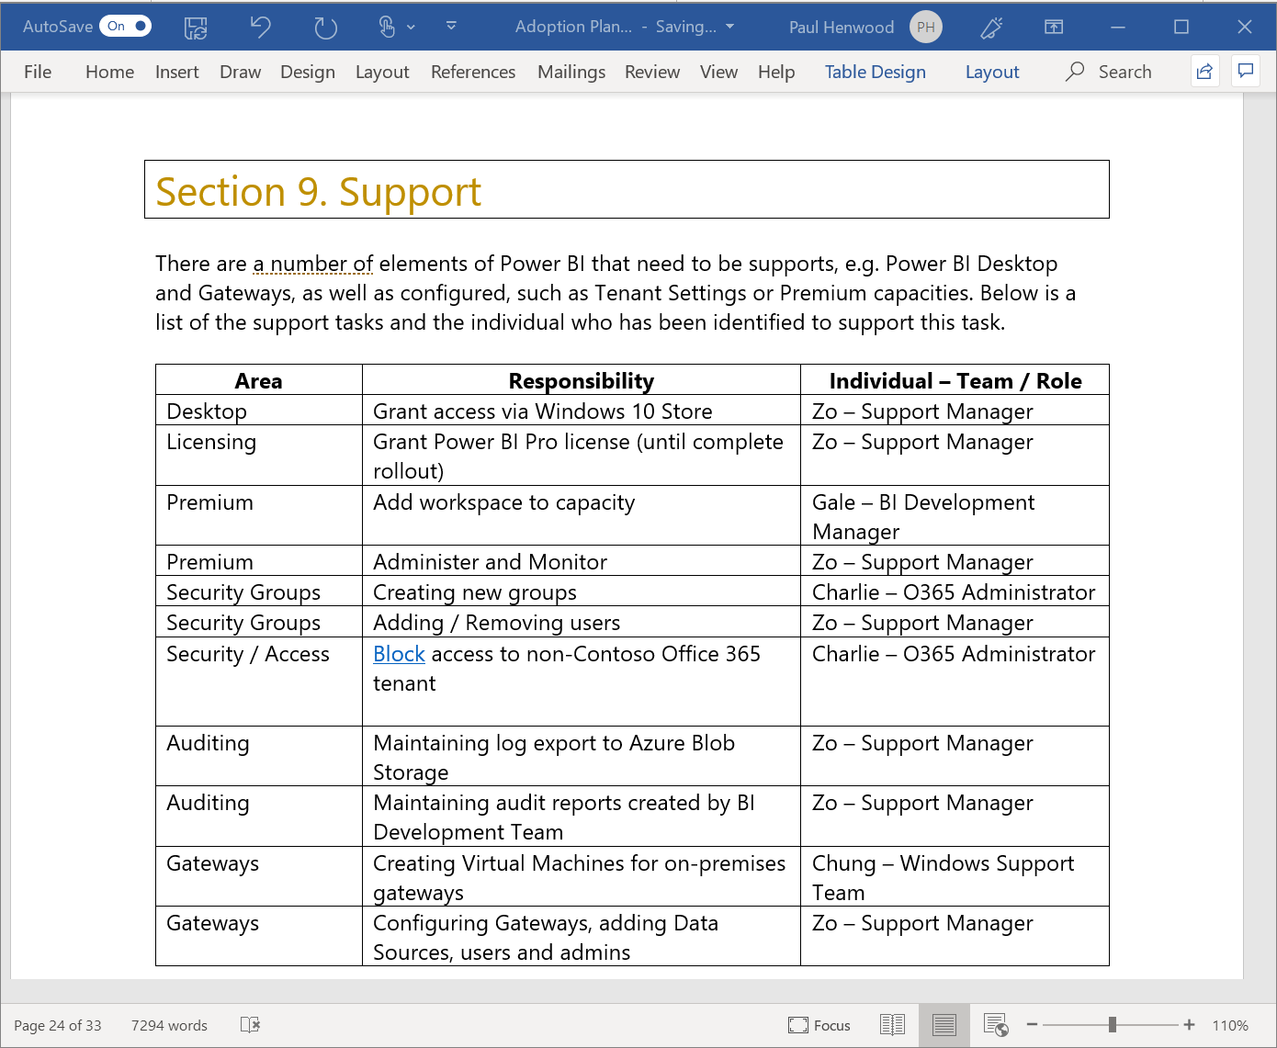
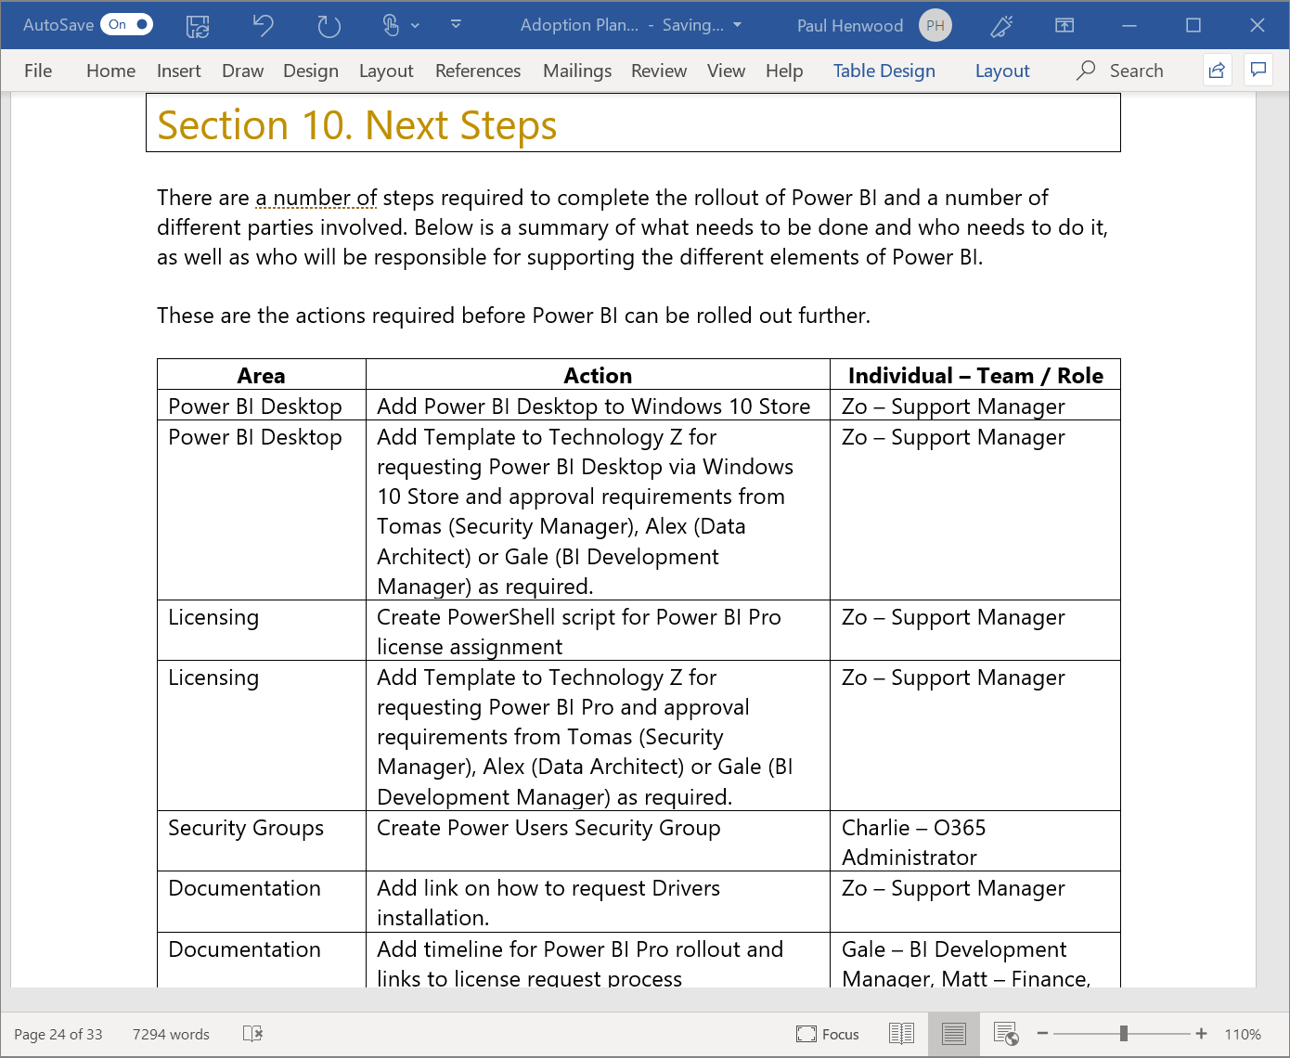
Adoption Framework - Output

Slide 14
Key Features, Benefits & Drivers
Key Features and Benefits:
Develop a Business Intelligence Platform based on Power BI to support the changing demands of your organisation.
Build a capability to rapidly answer business questions and make more informed decisions.
Develop the mindset associated with agile delivery of Business Intelligence.
Key Drivers:
Readiness to adopt an agile Business Intelligence culture.
Business data that could provide meaningful insights and help drive decisions.
Business/IT Collaboration.

Slide 15
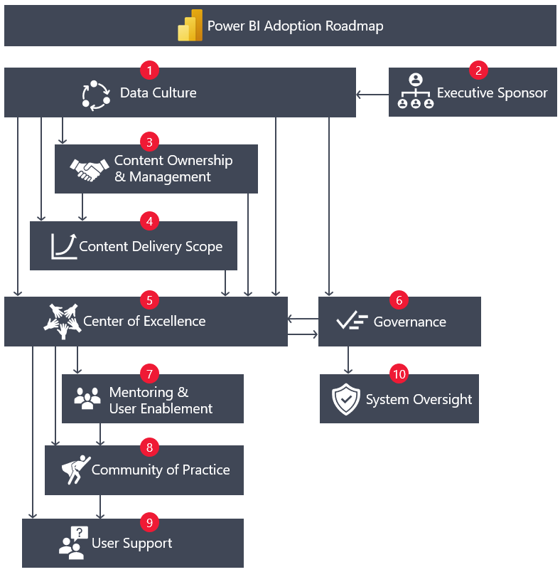
Adoption Roadmap

Slide 16
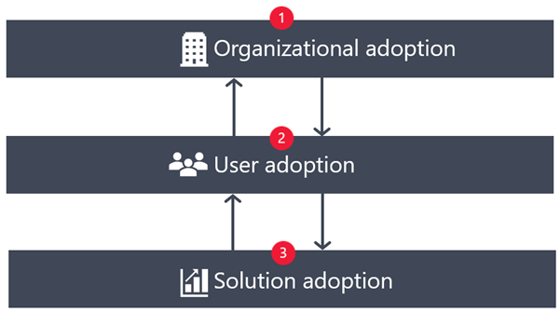
Types of Adoptions

Slide 17
Organization Adoption
Level 500
Level 400
Level 300
Efficient
Level 200
Capable
Level 100
Value of Power BI solutions is prevalent in the organization, and Power BI is widely accepted throughout the organization
Power BI skillsets are highly valued in the organization, and they are recognized by leadership
The internal Power BI community is self-sustaining, with support from the COE
Continuous improvement as continual priority
Use of automation adds value, improves productivity, or reduces risk for error
Defined
Power BI is commonly used for delivering critical content throughout the organization.
Established and accepted governance model with cooperation from all key business units.
Training, documentation, and resources are actively used by the Power BI community of users.
Standardized processes for oversight and monitoring of Power BI usage and practices.
The Power BI COE includes representation from all key business units.
Repeatable
Progress on standardization of repeatable practices
Established COE with clear goals and scopes of responsibilities.
Internal community with growing number of user and champions emerging
Initial investments in training, documentation, and resources
Initial governance model in place
Power BI has an active and engaged executive sponsor.
Roles and responsibilities for all Power BI stakeholders are well understood.
Initial
Quick wins has been a priority
Lack of a coordinated strategy or governance approach
Few formal processes in place for effective data management
Risk due to a lack of awareness of how data is used
Potential for a strategic investment with Power BI is acknowledged, but no clear path for organization-wide execution.
Certain Power BI content is now critical in importance and/or it is broadly used by the organization
Attempts to document and define repeatable practices, but efforts are siloed, reactive with varying levels of success
Power BI adoptions continues to grow organically and produces value, however it takes place in an uncontrolled way.
Initial planning for a consistent Power BI governance strategy is underway.

Slide 18
User Adoption
Phase 4
Phase 3
Phase 2
Proficiency
Phase 1
Momentum
Understanding
Actively uses Power BI on a regular basis.
Understands how to use Power BI in the way in which it was intended, as relevant for their role.
Modifies their behavior and activities to align with organizational governance processes.
Willingness to support organizational processes and change efforts is growing over time, and they become an advocate for Power BI in the organization.
Makes the effort to continually improve their skills and stay current with new product capabilities and features.
Awareness
An individual actively gains Power BI skills by attending formal training, self-directed learning, or experimentation.
Gains basic competency with the aspects of Power BI relevant to their role.
An individual develops understanding of the benefits of Power BI to deliver analytical value and support decision-making.
Shows interest and starts to use Power BI.
An individual has heard of, or been initially exposed to, Power BI in some way.
May have access to Power BI but is not yet actively using it.

Slide 19
Solution Adoption
Stage 4
Stage 3
Stage 2
Essential
Stage 1
Valuable
Target users actively and routinely use the solution, and it's considered essential for decision-making purposes.
Change management and release management is carefully controlled due to the impact of changes.
A subset of users regularly provide feedback to ensure the solution continues to meet requirements.
Expectations for the success of the solution are clear and are measured.
Expectations for support of the solution are clear, especially if there are service level agreements.
The solution aligns with organizational governance guidelines and practices.
Functional
Target users find the solution is valuable and experience tangible benefits.
Solution is promoted to a production workspace.
Validations and testing to ensure data quality, accurate presentation, accessibility, and acceptable performance.
Usage metrics for the solution are actively monitored.
User feedback loops to facilitate suggestions and improvements that can contribute to future releases.
Ownership and subject matter experts for the content is clear.
Exploration
The solution is functional and meets the basic set of user requirements. There are likely plans to iterate on improvements and enhancements.
The solution is deployed to the Power BI service.
All necessary supporting components are in place, such as gateways to support scheduled refresh.
Users are aware of the solution and show interest in using it. Potentially, it may be a limited preview release, and may not yet be ready to promote to a production workspace.
Exploration and experimentation are the main approaches to testing out new ideas. Exploration of new ideas can occur through informal self-service BI, or through a formal POC, which is purposely narrow in scope. The goal is to confirm requirements, validate assumptions, address unknowns, and mitigate risks.
A small group of users test the POC solution and provide useful feedback.
All exploration—and initial feedback—could occur within Power BI Desktop or Excel. Use of the Power BI service is limited.

Slide 20
Data Culture
1

Slide 21
What led to this series…
Customer Need
BI Champs
Customer & Partner Feedback
Power BI Whitepapers
Power BI Product Group
BI @ Microsoft

Slide 22
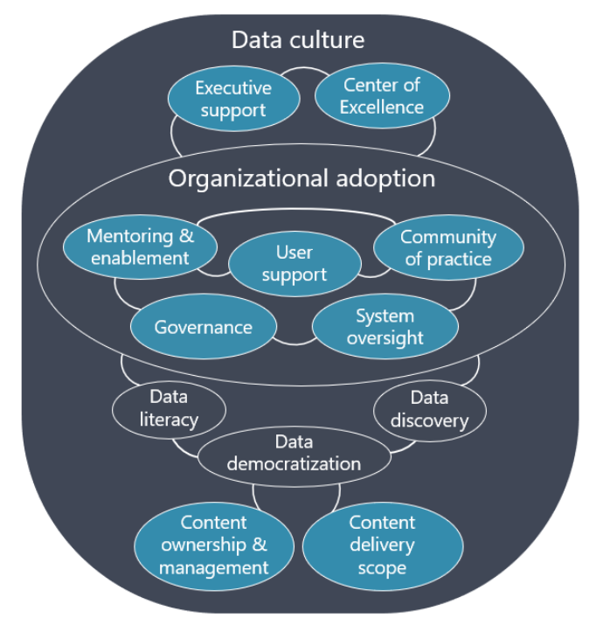
Inter-related Aspects influencing Data Culture

Slide 23
Motivation for Data Culture Adoption
01. Reactive Change
01
Responding to new agile competition
Main Initiatives
03. External Changes
02. Proactive Change
Pressure to eliminate inefficiencies and redundancies during economic downturn
Initiating a new line of business
Expanding into new markets to seize a “green field” opportunity
03
02

Slide 24
Components of the Healthy Data Culture
Originate from the executive level.
Align with organizational objectives.
Healthy Data Culture
Directly influence your adoption strategy.
Serve as the high-level guiding principles for enacting governance policies and guidelines.

Slide 25


Main Aspects of Data Culture
Data Discovery: “Find the Data”
Importance of the relevant data sources and artifacts
Simple and clear process of data access
Power BI:
the datasets hub and use of endorsements
Use of Azure Purview
Data Literacy: “Understand the data”
Data Democratization: “Use the Data”
The ability to interpret, create, and communicate data accurately and effectively
Shared responsibility of the data resources
Reduction of shadow IT

Slide 26
Data Discovery
Encouraging the use of trusted high-quality data source
Main Features
Working with the right data in day-to-day activities
The ability to effectively search for, and locate, relevant data sources and artifacts across the organization
Encouraging users to take advantage of investments in existing data resources
Promoting the use and enrichment of existing Power BI artifacts.
Helping people understand who owns and manages data artifacts.
Establishing connections between consumers, creators, and owners.

Slide 27
Data Democratization
Who is permitted to have Power BI Desktop installed?
Main Features
Putting data into the hands of more users who are responsible for solving business problems.
Enabling users to make decisions with the data.
Who is permitted to have Power BI Pro or Power BI Premium Per User (PPU) licenses?
Are there data sources that are strongly preferred?
Who can manage content? Is this decision different for data versus reports?
Who can consume content? Is this decision different for external partners, customers, and suppliers?

Slide 28
Data Literacy
Interpreting charts and graphs.
Main Features
The ability to interpret, create, and communicate data accurately and effectively.
Factors that matter:
current user skillsets
complexity of the data
required types of analytics
Assessing the validity of data.
Performing root cause analysis.
Discerning correlation and causation.
Using storytelling to help consumers quickly understand and act.

Slide 29





Key Actions
01
Define the type of data culture for your organization
02
Talk to stakeholders in business units to define what analytical practices for data-driven decisions are currently used
03
Talk to stakeholders in IT, BI, and/or CoE to understand governance constraints.
04
Verify the level of executive sponsorship.
05
Define purposeful BI strategy.
06
Develop an action plan for immediate, short-term, and long-term action items.

Slide 30
Recommendations on Data Culture
Define the type of data culture for your organization
Talk to stakeholders in business units to define what analytical practices for data-driven decisions are currently used
Talk to stakeholders in IT, BI, and/or CoE to understand governance constraints.
Verify the level of executive sponsorship.
Define purposeful BI strategy.
Develop an action plan for immediate, short-term, and long-term action items.

Slide 31
Maturity Level – Data Culture
Level | State of data culture
100: Initial | There are business intelligence (BI) initiatives taking place—with some successes—in various areas of the organization. These activities are occurring in a somewhat chaotic manner, with few formal processes, and without a strategic plan. A significant backlog of requests may exist for the enterprise BI team. There is a lack of oversight and visibility into self-service BI operations. The successes or failures of BI solutions are not well-understood.
200: Repeatable | Multiple teams have had measurable successes with self-service BI solutions. Investments are made to identify the ideal balance of enterprise BI and self-service BI.
300: Defined | Specific goals are established for advancing the data culture, and these goals are implemented incrementally. Effective self-service BI practices are incrementally—and purposely—replicated throughout more areas of the organization.
400: Capable | The data culture goals to employ informed decision-making are aligned with organizational objectives, actively supported by the executive sponsor, and directly impact on the adoption strategies put into place. A healthy and productive partnership exists between the COE, business units, and IT. It's common that individuals who take initiative in building valuable BI solutions are recognized and rewarded.
500: Efficient | Regular review of key performance indicators validate that data culture results are aligned with intentions. The business value of BI solutions is regularly evaluated and measured; feedback loops encourage ongoing improvements. Continual improvement of organizational adoption, user adoption, and solution adoption are top priorities. Learnings are incrementally adapted throughout the organization on an ongoing basis.

Slide 32
Introduction to the Framework

Slide 33
Envision – Key Learning
Feasible and impactful
Permission/approvals
Non-sensitive data
Business shadowing

Slide 34



Power BI Adoption Methodology
On-board
Select a Project
Adoption Workshop
Address Data Quality
Implement Project

Slide 35



Power BI Adoption Methodology
Drive value
Center of Excellence
Internal Marketing
End User Training
Internal Community

Slide 36




Adoption Framework Workshops
Governance
Service Management
Security
Rollout &
Support
Current State
Why Govern?
Governance Considerations
Governance Model
Data Sources
Data governance
Master Data Management
Enterprise Data Catalog
Enterprise Data Dictionary
Licensing
Setup
Group Management
Tenant Administration
Application Management
Monitoring
Connectivity
Identity
Power BI Architecture
Access Controls
Connectivity
Data Security
Sharing
Roles and responsibilities
Phased vs organization wide roll out
Rollout Planning
Training requirements
Communication
Support Scenarios
Ways of working
Center of Excellence

Slide 37
Adoption Framework Workshop Attendees
Governance
Service Management
Security
Rollout &
Support
Corporate Sponsor
Power BI Champion(s)
Data/Info Security Manager
Data Architect
Data Steward
BI Developer
Power BI Champion(s)
Data/Info Security Manager
Service Delivery Manager
Power BI Administrator
Business Support Specialist
BI Developer
Power BI Champion(s)
Data/Info Security Manager
Data Architect
Data Steward
BI Developer
Power BI Administrator
Business Support Specialist
Power BI Champion(s)
Data Architect
BI Developer
Power BI Administrator
Service Delivery Manager
Business Support Specialist

Slide 38
Adoption Framework Workshop Key Learnings
Involve IT, Business & Security
Leverage existing relationships
Propose options & recommend
Environment & culture

Slide 39
Executive Sponsor
2

Slide 40
Funding Approach
Centrally Funded
Business Funded

Slide 41
Responsibilities of Executive Sponsor
Formulating a strategic vision and priorities for BI and analytics.
Leading by example by actively using Power BI in a way that's consistent with data culture and adoption goals.
Allocating staffing and prioritizing resources.
Approving funding (for example, Power BI licenses).
Communicating announcements that are of critical importance.
Decision-making, particularly for strategic-level governance decisions.
Dispute resolution (for escalated issues that cannot be resolved by operational or tactical personnel).
Supporting organizational changes (e.g., creating or expanding the COE).

Slide 42
Key Requirements
Sponsorship
Obtaining executive sponsorship and communicating it
Goals
Aligning program goals to corporate goals
Planning
Planning strategy and execution, and measuring the program

Slide 43
Identifying an Executive Sponsor
Top-down Patter
Bottom-up Pattern
Selected by a more senior executive
E.g., the Chief Executive Officer may hire a Chief Data Officer or Chief Analytics Officer for executive sponsor of Power BI
A candidate will appear due to the success they’ve experienced with BI.
More likely to appear in smaller organizations.
No formal authority over other business units

Slide 44
Key Actions
01
Clarify on who your executive sponsor is.
02
Identify someone in a sufficient position of influence and authority.
03
Involve an executive sponsor in all strategic-level governance decisions.
04
Involve an executive sponsor in all data culture intiatives.
05
Consider naming a backup executive sponsor.
06
Identify influential advocates within the leadership team for each business unit.

Slide 45
Considerations& Key Actions
Clarify on who your executive sponsor is.
Identify someone in a sufficient position of influence and authority.
Involve an executive sponsor in all strategic-level governance decisions.
Involve an executive sponsor in all data culture intiatives.
Consider naming a backup executive sponsor.
Identify influential advocates within the leadership team for each business unit.

Slide 46
Maturity Level – Executive Sponsor
Level | State of Power BI executive support
100: Initial | There is awareness from at least one executive about the strategic importance of how Power BI can play a part in advancing the organization's data culture goals. However, neither a Power BI sponsor nor an executive-level decision-maker is identified.
200: Repeatable | Executive support exists for Power BI through informal channels and relationships.
300: Defined | A formal arrangement exists for C-level Power BI sponsorship and support, with well-understood expectations for the role.
400: Capable | Senior-level support is in place to grow and sustain the investment in Power BI by someone with sufficient authority across organizational boundaries.
500: Efficient | Executive support is a driver for advancing the data culture vision. The executive sponsor is involved with ongoing organizational adoption improvements, and measurable goals are in place.

Slide 47
Governance
3

Slide 48
PowerBI Governance: Why Do We Need It?

Slide 49
Nearly everyone across the organization engages with software
Yet, fewer than 25% of workers have access to analytical insights

Slide 50
Today, BI extends to everyone
3rd wave End user BI
Everyone
2nd wave Self-service BI
Analyst to end user
1st wave Technical BI
IT to end user

Slide 51

What if you could empower everyone with analytics anywhere decisions are made?

Slide 52
Turning Data into Business Insights
Common BI challenges include…
End-to-end view
Data often resides in disparate locations, making it difficult to see a complete picture of your business
Multiple data sources
Data residing in cloud solutions and on-premise locations is difficult to access and refresh securely
Right data for the right users at the right time
Different roles have different needs and business users need the latest operational data

Slide 53








Uncontrolled proliferation of BI apps

Slide 54
Why Governance is Needed
Plan ahead for self-service BI success
Avoid uncontrolled proliferation of BI apps
Implement processes
Proper governance processes
Drive Decisions
Reduce Risks
Increase user adoption

Slide 55
Governance Objectives
Empowerment with Data Culture
Guidance for improved user experience
Appropriate Data Usage
Consistency & Standardization
Clear Ownership & Stewardship
Reduce Risk of Data Misuse & Leakage
Meet Regulatory Requirements

Slide 56
Governance Objectives/Strategy
Empowerment
Empowering people throughout the organization to use data and make decisions, within the defined boundaries.
Guidance
Improving the user experience by providing clear and transparent guidance (with minimal friction) on what actions are permitted, why, and how.
Appropriate Data Use
Ensuring that the data usage is appropriate for the needs of the business.
Consistency
Enhancing the consistency and standardization of working with data across organizational boundaries.
Ownership & Stewardship
Ensuring that data ownership and stewardship responsibilities are clear.
Reduce Risk
Reducing risk of data leakage and misuse of data.
Meet Requirements
Meeting regulatory, industry, and internal requirements for the proper use of data.

Slide 57






Important Considerations
Secure data uploaded to the service
Publish data to the entire organisation
Share content to external users
Publish to web
Custom visuals
Audit logs
If you don’t decide upfront, someone else will later

Slide 58
PowerBI Governance: What Do We Need?

Slide 59
What is your organisation’s current state of BI?
Actions
Document current technologies

Slide 60
What organizational goals do you want to achieve with the roll out of Power BI?
Consolidate BI Tooling
Self-Service BI
Live Dashboards

Slide 61
Environment Administration
Tenant Settings
Roles and Responsibilities
Enterprise Gateways
Security standards
Sharing
Environment and Reporting consistency
Published source data and business data models
Power BI
Governance

Slide 62

Which ones
How
Catalog
Define
Quality
Security
Data Asset
Governance

Slide 63
What data sources are accessible for analysis?
Key Areas to Discuss
Location
Data Source type
Size
Refresh frequency
Who can access
How can someone request access
Monitoring
Performance implications

Slide 64
PowerBI Governance: How Do We Want to Achieve It?

Slide 65
Implementing Governance
Balance the needs of IT and the business
Every enterprise is unique
Determine initial principles and goals
Clarify ownerships of business information and content

Slide 66
Data Discovery
Power BI
Machine Learning
Big Data Analytics
Visualisation
Operational Reporting
Ad hoc Reporting
Centralized Control vs. Decentralized Empowerment

Slide 67
Governance Model
TIGHT CONTROLS
EDW
Permanent record
Subject to compliance
Push down content
Reporting services
BUSINESS UNIT
DASHBOARDS, KPIs & SCORECARDS
Push up content
Power BI Desktop
Excel or other reports
Knowledge management
Information sharing
DEPARTMENTAL, TEAM OR GROUP REPORTING
PROJECT REPORTING
Personal/Private views
Data science exploration
PERSONAL REPORTING
LESS CONTROLS

Slide 68









Evolution of BI
Corporate BI
Self-Service BI
Provision
Analysis
Reports
Dashboards & Scorecards
End Users
Data
Staging
ETL/Data Quality
Analysis
Cubes
Data Warehouse
Specialized Tools
?
Existing Data
Spreadsheets
LOB Applications
Data Marts
Files
IT Pro
Is it possible to balance Control with Agility?

Slide 69
A balanced approach…
Power BI
Analysis
Cubes
Data Warehouse
Existing Data
LOB Applications
Data Marts
Files
Power BI/Excel
IT Pro
End Users

Slide 70
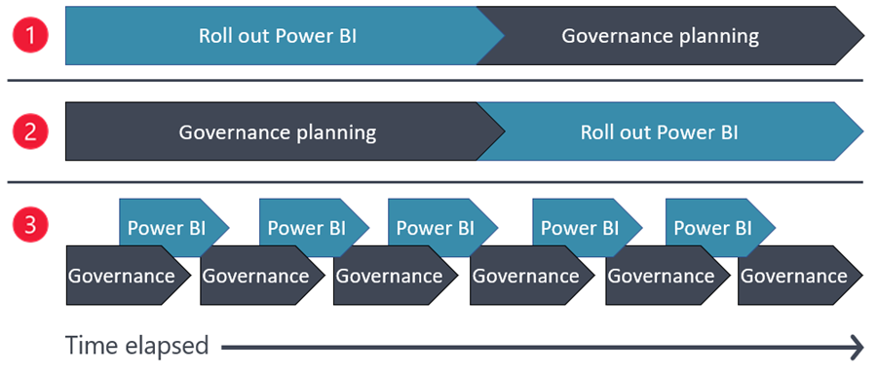
Methods of introducing governance

Slide 71
Governance Challenges
Strategy
Lack of a cohesive data governance strategy that aligns with the business strategy.
Lack of executive support for governing data as a strategic asset.
Insufficient adoption planning for advancing adoption and the maturity level of BI and analytics.
People
Lack of aligned priorities between centralized teams and business units.
Lack of identified champions with sufficient expertise and enthusiasm throughout the business units to advance organizational adoption objectives.
Lack of awareness of self-service best practices.
Duplicate effort spent across business units.
Lack of clear accountability, roles, and responsibilities.
Process
Lack of clearly defined processes resulting in chaos and inconsistencies.
Lack of standardization or repeatability.
Insufficient ability to communicate and share lessons learned.
Lack of documentation and over-reliance on tribal knowledge.
Inability to comply with security and privacy requirements.

Slide 72
Governance Challenges
Data quality and Data management
Sprawl of data and reports.
Inaccurate, incomplete, or outdated data.
Lack of trust in the data, especially for self-service content.
Inconsistent reports produced without data validation.
Valuable data not used or difficult to access.
Fragmented, siloed, and duplicated datasets.
Unclear data ownership and stewardship.
Skills and Data Literacy
Varying levels of ability to interpret, create, and communicate with data effectively.
Varying levels of technical skillsets and skill gaps.
Lack of ability to confidently manage data diversity and volume.
Underestimating the level of complexity for BI solution development and management throughout its entire lifecycle.
Coping with the speed of change for cloud services.

Slide 73




User adoption
Corporate sponsorship
Power BI champions
Balance with flexibility & ability to be productive
Developing a culture of analytics

Slide 74
Lightweight Governance Model
Co-defined governance decisions
Governance as part of user’s regular workflow
Clear, transparent rules for governance requirements regarding data access, usage and sharing
Alignment with organizational data culture goals
Success Factors

Slide 75
System usage
Security
Report performance
Data source usage
Governance Monitoring

Slide 76
Governance Considerations
Does BI start top down or bottom up?
Where does change start? Technology or people?
Who should be allowed to see and use business intelligence data?
Fail quickly? What do you mean by that and how does it apply to business intelligence?

Slide 77
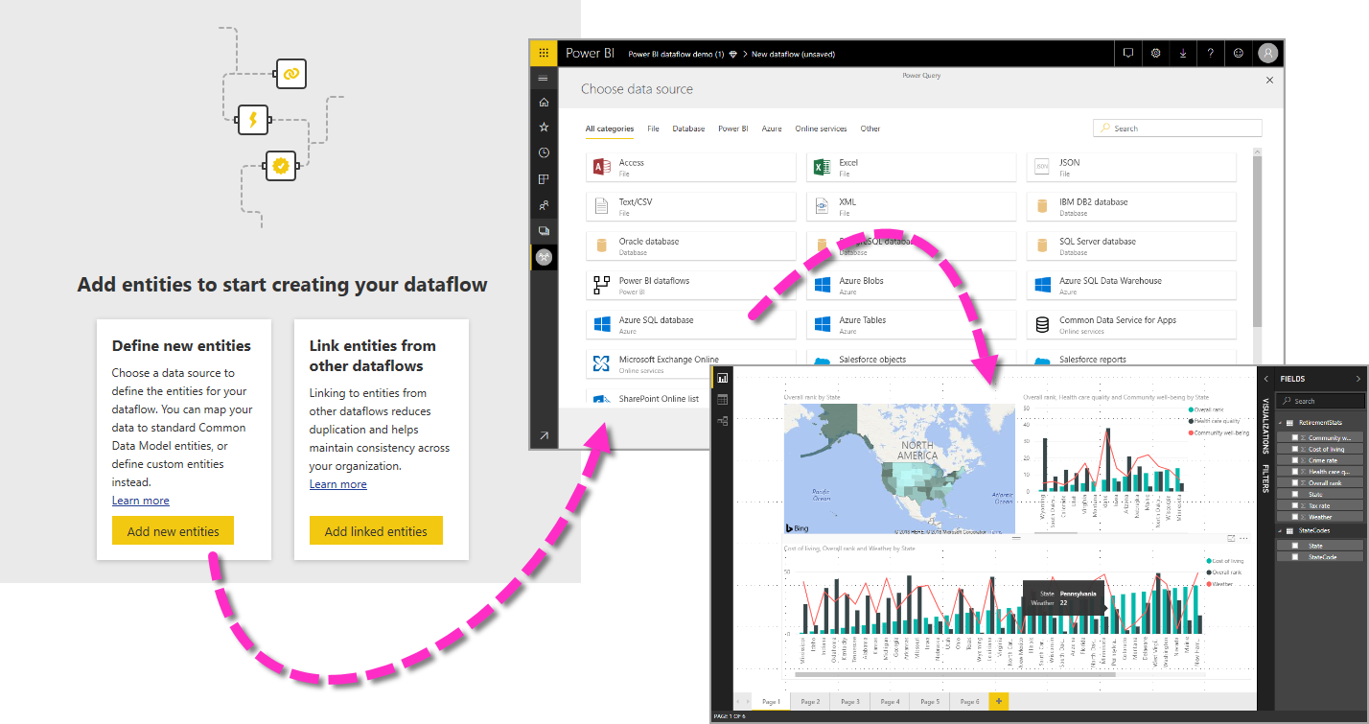
IT prepared and cleansed enterprise-wide master data
Master Data Management

Slide 78
Do you currently have a Master Data Management Process?
Actions
Document current process

Slide 79
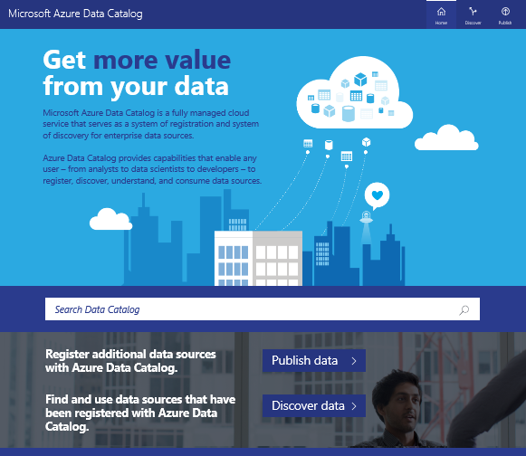
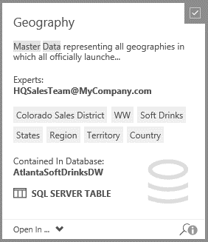
One stop reference directory for all Enterprise Data Assets
Enterprise Data Catalog

Slide 80
Do you currently have an Enterprise Data Catalog?
Actions
Document current implementation

Slide 81
Field Name | Source | Calculation | Description
Gross Profit | dbname.servername | …….. | ……..
Enterprise Data Dictionary

Slide 82
Do you currently have an Enterprise Data Dictionary?
Actions
Document current implementation

Slide 83
Key Roles & Responsibilities
Chief Data/Analytics Officer
Executive Sponsor
Data Governance Team
Data Architect
Data Steward
BI Developer
Power BI Champion
Power BI Administrator
Data/Information Security Manager

Slide 84

Executive Sponsor
Persona quote
“I am responsible for the strategic direction of the organisation and am keen to enable self-service BI in order to empower each and every individual”
Role requirements/skills
Ability to influence organisational strategy around the use of BI tools
Responsibilities
Promotes adoption and the successful use of Power BI.
Prioritisation of business areas, ensures alignment with business objectives, principles and policies
Project approval and sign-off

Slide 85
Chief Data/Analytics Officer
Persona quote
“I am responsible for the strategic direction of the organisation and am keen to enable self-service BI in order to empower each and every individual”
Role requirements/skills
Ability to influence and lead organisational strategy around the use of BI tools
Responsibilities
Defines the strategy for use of data as an enterprise asset.
Oversees enterprise-wide governance guidelines and policies.

Slide 86

Data Governance Team
Persona quote
“We oversee the organization-wide governance and continually work on optimizing it.“
Role requirements/skills
Understand governance and sees opportunities of optimization
Responsibilities
Creates governance policies, standards, and processes.
Provides enterprise-wide oversight and optimization of data integrity, trustworthiness, privacy, and usability.
Collaborates with the COE to provide governance education, support, and mentoring to data owners and content creators.

Slide 87

Center of Excellence (COE)
Persona quote
“We help the community to effectively use Power BI.”
Role requirements/skills
Understand analytics vision of organization, have desire to continually improve practices and effective usage/adoption of PBI in organization.
Responsibilities
Mentors the community of creators and consumers to promote the effective use of Power BI for decision-making.
Provides cross-departmental coordination of Power BI activities to improve practices, increase consistency, and reduce inefficiencies.

Slide 88
Data Architect
Persona quote
“I design a technical architecture based on the business requirements”
Role requirements/skills
Knowledge of on premises and cloud data technologies
Responsibilities
Matching business requirements with technical capabilities
Developing an architecture that meets the security and governance standards of the organisation

Slide 89

Data Steward
Persona quote
"I create and maintain business metadata and rules, assess and enhance data quality, and share and collaborate across business and technical stakeholders“
Role requirements/skills
Data modelling, mashups and provisioning
Responsibilities
Create and maintain business Metadata
Enhance/ensure data quality
Maintain the Data Catalogue, and the Data Dictionary

Slide 90
Power BI Administrator
Persona quote
“I make sure that the services configured correctly and ensure that the services are appropriately monitored”
Role requirements/skills
Knowledge of IT Service management, authentication
Responsibilities
Initial set up
Coordination with the O365/Azure admins
License assignment
Set up for monitoring of the service
Gateway management

Slide 91
Power BI Champion
Persona quote
“I help teams in adopting self-service BI”
Role requirements/skills
Subject matter experts (SMEs) who are also Excel/BI savvy and develop full understanding of the capabilities of Power BI
Responsibilities
Help evangelize the vision of a data driven culture
Strategically deploy Power BI across the organization or team

Slide 92
BI Developer
Persona quote
“I develop BI solutions and enable data sources for self-service BI”
Role requirements/skills
Full understanding of the capabilities of the Microsoft BI platform
Responsibilities
Make new data sources available for self-service
Develop new IT delivered solutions
Enhance existing solutions
Release management process

Slide 93
Data/Information Security Manager
Persona quote
“I ensure that we follow all security compliance policies, our data is always stored securely and accessible”
Role requirements/skills
Knowledge of IT Service management, auditing, security
Data Classification
Responsibilities
Data Residence
Auditing
Data Policy enforcement

Slide 94
Service Delivery Manager
Persona quote
“I ensure smooth running of all Power BI solutions”
Role requirements/skills
Service and gateway monitoring and configuration, Power BI Development, release management
Responsibilities
Service status monitoring and issue resolution
Grant access to Power BI app workspaces
Gateway support
Minor enhancements
Release management of code changes

Slide 95
Business Support Specialist
Persona quote
“I help business users in developing Power BI solutions”
Role requirements/skills
Power BI Development
Responsibilities
Support business users with complex modelling scenarios
Help with data visualisations including custom visuals and R visuals
Create reusable templates for business users

Slide 96
More Roles
Change management board | Coordinates the requirements, processes, approvals, and scheduling for release management processes with the objective of reducing risk and minimizing the impact of changes to critical applications.
Project management office | Manages individual governance projects and the ongoing data governance program.
Information technology | Provides occasional assistance to Power BI administrators for services related to Power BI, such as Azure Active Directory, Microsoft 365, Teams, SharePoint, or OneDrive.
Risk management | Reviews and assesses data sharing and security risks. Defines ethical data policies and standards. Communicates regulatory and legal requirements.
Internal audit | Auditing of compliance with regulatory and internal requirements.

Slide 97
Key Actions
01
Document & communicate goals and guiding principles of data culture goals
02
Ensure understanding of how Power BI is currently used
03
Select an important pain point, high priority need, or known risk for a data domain for prioritizing which new guidelines or policies to create,
04
Determine if there is an inventory of all critical data assets or create one if necessary.
05
Confirm that you have support and sufficient attention from your executive sponsor, as well as from business unit leaders.
06
Evaluate the existing processes and policies you can immediately adopt for Power BI for consistency.
07
Determine how conflicts, issues, and requests for exceptions to documented policies will be handled.

Slide 98
Considerations & Key Actions
Document and communicate goals and guiding principles of data culture goals
Ensure understanding of how Power BI is currently used
Select an important pain point, high priority need, or known risk for a data domain for prioritizing which new guidelines or policies to create
Determine if there is an inventory of all critical data assets or create one if necessary
Confirm that you have support and sufficient attention from your executive sponsor, as well as from business unit leaders
Evaluate the existing processes and policies you can immediately adopt for Power BI for consistency
Determine the cadence for how often data policies are reevaluated
Determine how conflicts, issues, and requests for exceptions to documented policies will be handled

Slide 99
Action Plan
Initial priorities:
Select one data domain or business unit at a time.
Timeline:
Work in iterations long enough to accomplish meaningful progress, yet short enough to periodically adjust.
Quick wins:
Focus on tangible, tactical, and incremental progress.
Success metrics:
Create measurable metrics to evaluate progress.

Slide 100
Initial priorities:
Select one data domain or business unit at a time.
Timeline:
Work in iterations long enough to accomplish meaningful progress, yet short enough to periodically adjust.
Quick wins:
Focus on tangible, tactical, and incremental progress.
Success metrics:
Create measurable metrics to evaluate progress.
Action Plan

Slide 101
Maturity Level – Governance
Level | State of Power BI governance
100: Initial | Due to a lack of governance planning, the good data management and informal governance practices that are occurring are overly reliant on judgment and experience level of individuals. There's a significant reliance on undocumented tribal knowledge.
200: Repeatable | Certain areas of the organization have made a purposeful effort to standardize, improve, and document their data management and governance practices.
300: Defined | An approved plan with governance focus, objectives, and priorities is in place and broadly communicated. Roles and responsibilities are documented and understood. Governance guidelines and policies are implemented for the top few priorities (pain points or opportunities) and are actively followed by the COE and the community of users.
400: Capable | Learnings from existing practices are continually enacted and scaled throughout the organization. It's clear where Power BI fits in to the overall BI strategy for the organization.
500: Efficient | All Power BI governance priorities align with business objectives. Measurable governance goals are clear and tracked regularly for iterative, continual progress. Transparency and communication are a priority.

Slide 102
Content Delivery Scope
3

Slide 103
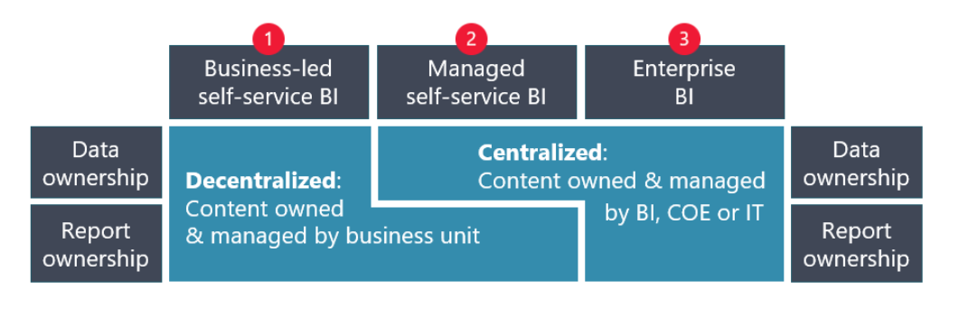
Content Ownership and Management

Slide 104
Governance Level based on Content Ownership
Business-led self-service BI
Least stringent governance and oversight controls for the content
Managed- self-service BI
Moderately stringent governance and oversight controls for the content
Enterprise BI solutions
More rigorous governance controls and oversight for the content

Slide 105
Business-led self-service BI: Bottom-Up Approach
5
Flexibility to response to changing business conditions and fast reaction
4
Skilled and motivated people from business unit to support solutions
3
High involvement from the business unit and high level of control
2
Data exploration and freedom to innovate
Bottom-Up
1
Data management is aligned with the organization’s data culture

Slide 106
Business-led self-service BI – Guidelines for Success
01
Usage of Similar Techniques
Teach your creators to use the same techniques that IT would use, like shared datasets and dataflows. Having fewer duplicated datasets reduces maintenance, improves consistency, and reduces risk.
02
Appropriate Resource Provision
Focus on providing mentoring, training, resources, and documentation. Be prepared for skill levels of self-service content creators to vary significantly.
03
Endorsements Usage
Provide guidance on the best way to use endorsements. Consider reserving use of the certified endorsement for enterprise BI content and managed self-service BI content.
04
Activity Log Analysis
Analyze the activity log to discover situations where the COE could proactively contact self-service owners to offer helpful information. It's especially useful when a suboptimal usage pattern is detected.

Slide 107
Business-led self-service BI – Guidelines for Success
Teach your creators to use the same techniques that IT would use, like shared datasets and dataflows. Having fewer duplicated datasets reduces maintenance, improves consistency, and reduces risk.
Focus on providing mentoring, training, resources, and documentation (described in the mentoring and user enablement article). The importance of these efforts can't be overstated. Be prepared for skill levels of self-service content creators to vary significantly. It's also common for a solution to deliver excellent business value yet be built in such a way that it won't scale or perform well over time (as historic data volumes increase). Having the COE available to help when these situations arise is very valuable.
Provide guidance on the best way to use endorsements. The promoted endorsement is for content produced by self-service creators. Consider reserving use of the certified endorsement for enterprise BI content and managed self-service BI content (discussed next).
Analyze the activity log to discover situations where the COE could proactively contact self-service owners to offer helpful information. It's especially useful when a suboptimal usage pattern is detected. For example, log activity could reveal overuse of individual item sharing when an app or workspace roles may be a better choice. The data from the activity log allows the COE to offer support and advice to the business units. In turn, this information can help increase the quality of solutions, while allowing the business to retain full ownership and control of their content.

Slide 108
Managed self-service BI: Blended Approach
1
Data management is aligned with the organization’s data culture
2
A team of BI experts who manage the data architecture
3
Reuse of data by many self-service report creators across organizational boundaries
4
Fast pace of report creation by self-service report team
5
Shared responsibility for data preparation, data modelling, and report creation

Slide 109
Managed Self-Service - Guidelines for Success
01
Separate Model and Report Development
Teach users to separate model and report development. They can use live connections to create reports based on existing datasets.
02
Use Dataflow for Data Logic
Use dataflows to centralize data preparation logic and to share commonly used data tables with many dataset creators. The use of dataflows reduces the number of data refreshes on source.
03
Use DirectQuery and Azure Analysis Services
This feature allows for an ideal balance of self-service enablement while taking advantage of the investment in data assets that are centrally managed.
04
Use Certified Endorsement
Use the certified endorsement for datasets and dataflows to help content creators identify trustworthy sources of data.

Slide 110
Managed Self-Service - Guidelines for Success
05
Use Consistent Branding
Include consistent branding on all reports to indicate who produced the content and who to contact for help.
06
Separate Workspaces for Storing Data and Reports
This approach allows for better clarity on who is responsible for content. It also allows for more restrictive workspace roles assignments.
07
Use Power BI REST APIs
Use the Power BI REST APIs to compile an inventory of Power BI artifacts. Analyze the ratio of datasets to reports to evaluate the extent of dataset reuse.

Slide 111
Enterprise BI: Top-Down Approach
1
Centralizing content management with a single team aligns with the organization's data culture.
2
BI expertise to manage all the BI artifacts end-to-end.
3
Well-defined content needs of consumers.
4
Limited access to content ownership and direct access to data.
Top-Down
5
High sensitivity of the data

Slide 112
Enterprise BI -Guidelines for Success
Implement a rigorous process for use of the certified endorsement for datasets, reports, and apps. Not all enterprise BI content needs to be certified, but much of it probably should be. Certified content should indicate that data quality has been validated. Certified content should also follow change management rules, have formal support, and be fully documented. Because certified content has passed rigorous standards, the expectations for trustworthiness are higher.
Include consistent branding on enterprise BI reports to indicate who produced the content, and who to contact for help. A small image or text label in the report footer is valuable when the report is exported from the Power BI service.
If you use specific report branding to indicate enterprise BI content, be careful with the save a copy functionality that would allow a user to download a copy of a report and personalize it. Although this functionality is an excellent way to bridge enterprise BI with managed self-service BI, it dilutes the value of the branding. A more seamless solution is to provide a separate Power BI Desktop template file for self-service authors. The template defines a starting point for report creation with a live connection to an existing dataset, and it doesn't include branding. The template file can be shared as a link within a Power BI app, or from the community site.

Slide 113
Enterprise BI -Guidelines for Success
01
Use rigorous Process for Certified Endorsement
Certified content should indicate that data quality has been validated and should also follow change management rules, have formal support, and be fully documented.
02
Consistent Branding on Enterprise BI reports
This approach helps to indicate who produced the content, and who to contact for help.
03
Power BI Desktop Template File Provision
Be careful with the save a copy functionality that would allow a user to download a copy of a report and personalize it. Provide a separate Power BI Desktop template file for self-service authors.

Slide 114
Power BI deployment modes
Power BI delivery: three approaches

Slide 115
Power BI deployment modes
Power BI as a prototyping tool

Slide 116
Ownership and Stewardship
Data Steward
Subject Matter Expert
Technical Owner
Domain Owner
Defining and/or managing quality levels
Master data management
Defining meaning of the data
Estimating the data usage reasons
Defining the access to the data
Collaborating with domain owner
Supporting colleagues in the use of data
Creating, maintain, publishing, and securing access to data and reporting artifacts
Making decisions who collaborates with governance teams on data management policies, processes, and requirements
Considering the appropriate and inappropriate uses of data

Slide 117
Maturity Level – Content Ownership
Level | State of Power BI content ownership and management
100: Initial | Content is owned and managed by self-service creators throughout the organization in an uncontrolled way, without a specific strategy. A high ratio of datasets to reports exists, indicating an opportunity to improve data reusability and reduce the number of duplicate datasets. Discrepancies between different reports is common, causing distrust of content produced by others.
200: Repeatable | A plan is in place for which content ownership and management strategy to use and in which circumstances. Initial steps are taken to improve the consistency and trustworthiness levels for self-service BI efforts. Guidance for the user community is available that includes expectations for self-service versus enterprise content.
300: Defined | Managed self-service BI is a priority and an area of investment to further advance the data culture. The priority is to allow report creators the flexibility they need while using well-managed, secure, and trustworthy data sources. Report branding is consistently used to indicate who produced the content. A mentoring program exists to educate self-service content creators on how to apply best practices and make good decisions.
400: Capable | Criteria is defined to align governance requirements for self-service versus enterprise content. There is a plan in place for how to request and handle ownership transfers. Managed self-service BI—and techniques for the reuse of data—are commonly used and well-understood.
500: Efficient | Proactive measures are in place to communicate with a user when any concerning user activities are detected in the activity log. External tools are used by highly proficient content creators to improve productivity and efficiency.

Slide 118
Content Delivery Scope
4

Slide 119
Four Delivery Scopes
Personal BI
Main Components
Enterprise BI
Team BI
Departmental BI

Slide 120
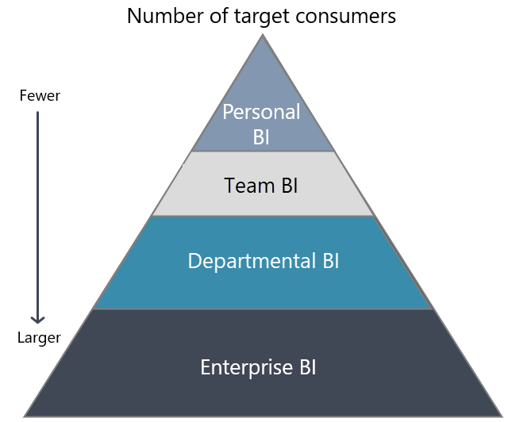
Target Consumers of the Content

Slide 121
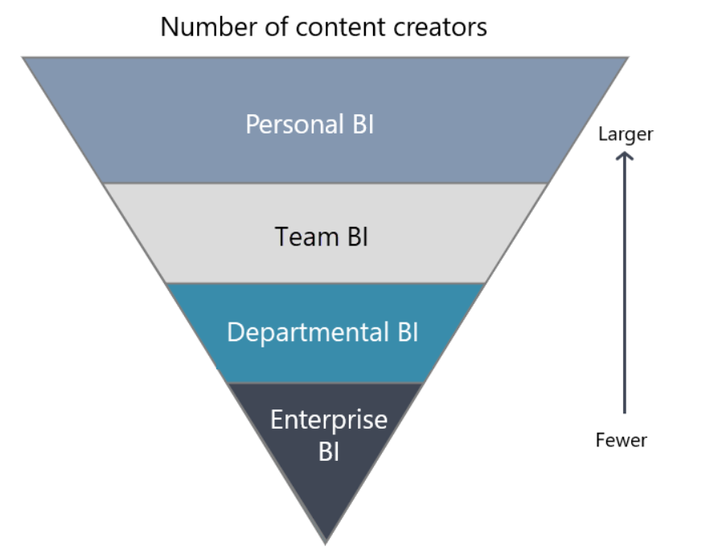
Creators of the Content

Slide 122
Personal BI
Personal BI
Effective personal use of data, information, and analytics by individuals (any type of workers)
The creator's primary intention is data exploration and analysis, rather than report delivery.
The content is intended to be analyzed and consumed by one person: the creator.
The content may be an exploratory proof of concept that may, or may not, evolve into a project.
Free Power BI license
Main
Components
Enterprise BI
Team BI
Departmental BI

Slide 123
Team BI
50
Personal BI
Collaborating and sharing content with each other in a workspace
Collaboration and co-management of content is the highest priority.
Formal delivery of reports may occur by report viewers (especially for managers of the team), but it's usually a secondary priority.
Reports aren't always highly sophisticated or attractive; functionality and accessing the information is what matters most.
Power BI Pro or Power BI Premium Per User (PPU) license.
Main
Components
Enterprise BI
Team BI
Departmental BI

Slide 124
Departmental BI
Personal BI
50
Content distribution to a larger number of consumers is a priority
Large number of consumers vs. small number of content creators.
Formal delivery of reports and apps is a high priority.
Additional effort is made to deliver more sophisticated and polished reports.
Needs for change management and application lifecycle management (ALM) begin to emerge to ensure release stability and a consistent experience for consumers.
Combination of Power BI Pro licenses, Premium Per User licenses, and/or Premium capacity licenses
Main
Components
Enterprise BI
Team BI
Departmental BI

Slide 125
Enterprise BI
50
A centralized end-to-end content management by BI experts.
Formal delivery of reports and apps is a high priority.
The content is highly sensitive, subject to regulatory requirements, or is considered extremely critical.
Published enterprise-level datasets and dataflows as a source for self-service creators, thus creating a chain of dependencies to the source data.
Stability and a consistent experience for consumers are highly important.
Application lifecycle management, such as deployment pipelines and DevOps techniques, is commonly used.
Change management processes to review and approve changes before they're deployed are commonly used for enterprise BI content.
Processes exist to gather requirements, prioritize efforts, and plan for new projects or enhancements to existing content.
Integration with other enterprise-level data architecture and management services may exist, possibly with other Azure services and Power Platform products.
Combination of Power BI Pro licenses, Premium Per User licenses, and/or Premium capacity licenses.
Personal BI
Main
Components
Enterprise BI
Team BI
Departmental BI

Slide 126
Phases of delivery: Self-Service BI
Phase 2
Tactical Prototyping
& Solution Creation
Phase 1
Current State
Assessment
Repeats for each project
Phase 4
Support, Training & Expansion
Phase 3
Publishing & Monitoring
Bottom-Up

Slide 127
Phases of delivery: Corporate BI
Phase 1
Requirements Discovery
Top-Down
Phase 5
Support, Training & Expansion
Phase 2
Strategic Prototyping
Repeats for each project
Phase 4
Development
Phase 3
Blueprinting

Slide 128
Phases of Delivery: Ownership Transfer
Ownership Transfer
Phase 1 - Publishing
Business to Corporate
Phase 2 - Certification
Phase 3 – Assume Ownership

Slide 129
Content Delivery -Key Actions
01
Guidelines, documentation, and other resources are aligned with the strategic goals defined for Power BI adoption
02
The scope for content delivery is clarified and is consistent with content ownership
03
Rules of content publishing in scope of an enterprise-wide audience for smaller teams.
04
Documentation for community with explanation when it's appropriate to use workspaces, apps, or sharing (direct access or link sharing)
05
Strategy for handling user licensing considerations for Power BI Pro, Premium Per User, and Premium capacity.

Slide 130
Considerations & Key Actions
Guidelines, documentation, and other resources are aligned with the strategic goals defined for Power BI adoption
The scope for content delivery is clarified and is consistent with content ownership
Rules of content publishing in scope of an enterprise-wide audience for smaller teams
Documentation for community with explanation when it's appropriate to use workspaces, apps, or sharing (direct access or link sharing)
Strategy for handling user licensing considerations for Power BI Pro, Premium Per User, and Premium capacity

Slide 131
Maturity Level – Content Delivery
Level | State of Power BI content delivery
100: Initial | Content is published by self-service creators in an uncontrolled way, without a specific strategy.
200: Repeatable | Pockets of good practices exist which depend on the knowledge, skills, and habits of the content creator.
300: Defined | Clear guidelines are defined and communicated to describe what can and cannot occur within each delivery scope. These guidelines are followed by some—but not all—groups across the organization.
400: Capable | Criteria are defined to align governance requirements for self-service versus enterprise content. Guidelines are followed by most, or all, groups across the organization. Change management requirements are in place to approve critical changes to content that is distributed to a larger audience. Changes are announced so creators are aware of the downstream effects on their content.
500: Efficient | Proactively communicate with a user when any concerning activities are detected in the activity log. Analysis is conducted regularly to evaluate the business value that's achieved for deployed solutions.

Slide 132



Data Refresh
Size Limitations
Security
Support
Benefits of ownership transfer to IT

Slide 133
Phases of Delivery: Ownership Transfer
Ownership Transfer
Phase 1 - Publishing
Corporate to Business
Phase 2 - Certification
Phase 3 – Assume Ownership

Slide 134
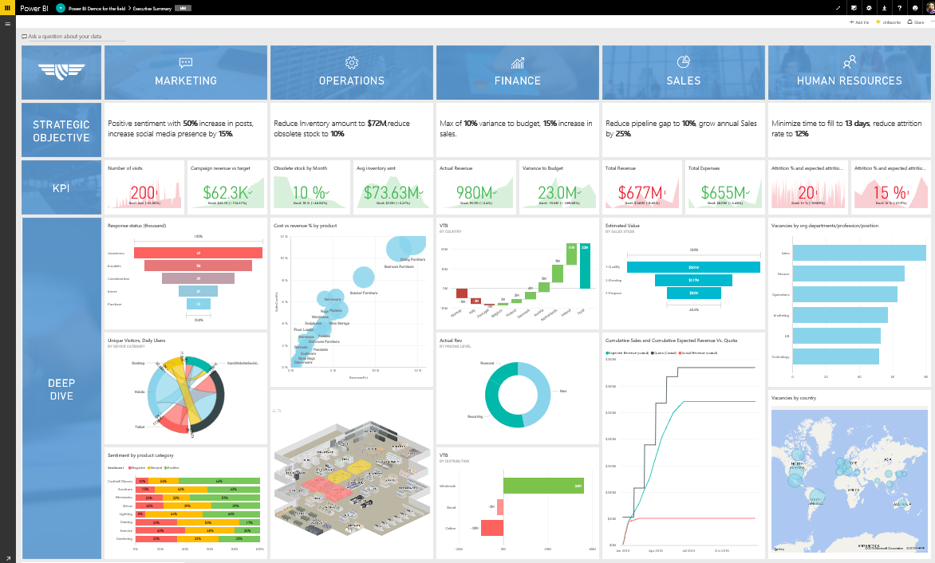
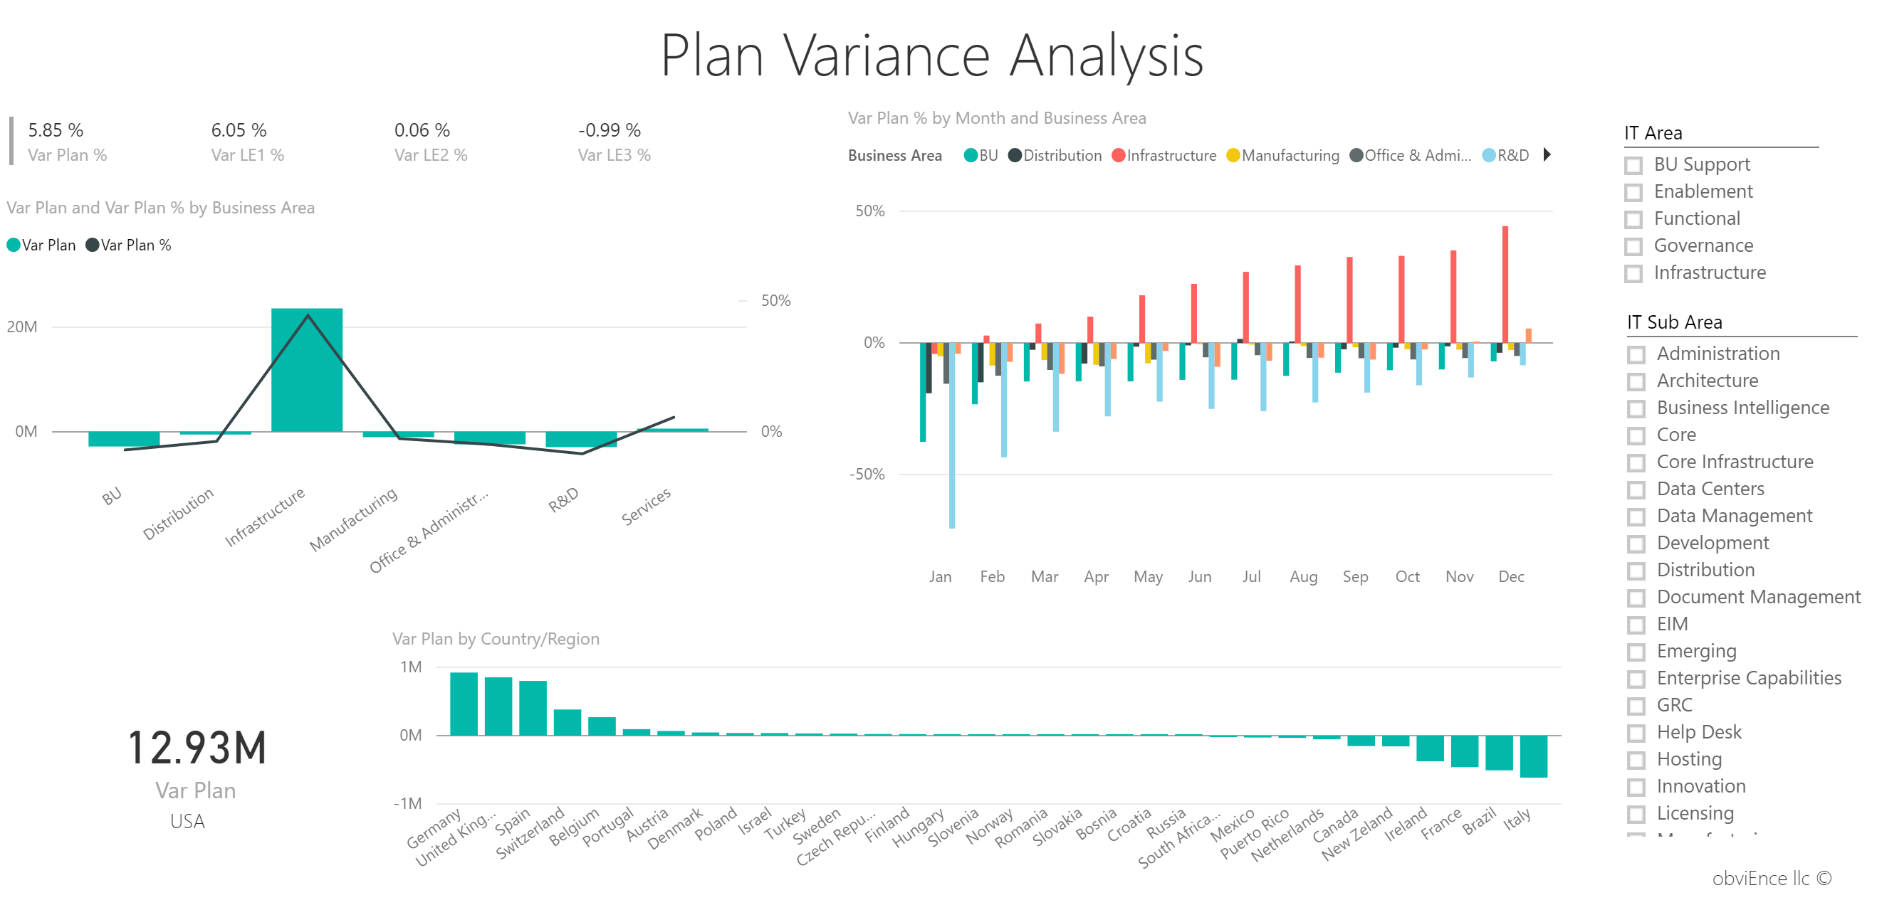
Create → Collaborate → Distribute
Development
Production
Distribute
Sharing
App Workspaces / Apps
Mobile apps
Embedding in apps
Static: PPT, Email
Other: Cortana, Publish to web, Static (Alerts, Print)
App Workspaces
App Workspaces
Co-owned Dashboards
Co-owned Dashboards
Co-owned Reports
Co-owned Reports
Co-owned Datasets
Co-owned Datasets
Co-owned Content packs
Co-owned Content packs

Slide 135
Center of Excellence (COE)
5

Slide 136
Learning from existing customers
Addressing Technical Issues
Clear BI Strategy
Plan
Exec Sponsor
User Community Profile
Data Quality
Compliance, Security, Governance
Infrastructure
Adoption Plan
Clear BI scenarios
Product Gaps
Centre of Excellence
Notes:
→ Same as in intro!

Slide 137
Center of Excellence
The Team
Initial Strategy, partnerships
Initial Setup
Implementation guidance, best practice, governance
Same roles, less involvement over time
Implementation can be partner led
Enablement - Training, continuous learning

Slide 138
Center of Excellence
Team OF EXPERTS
Funding model
Maintain Power bi platform
Implementation guidance, best practice, governance
Implementation can be partner led
Enablement - Training, continuous learning

Slide 139
Goals of COE
Evangelizing a data-driven culture
Promoting the adoption of Power BI
Nurturing, mentoring, guiding, and educating internal users
Coordinating efforts and disseminating knowledge across organizational boundaries
Creating consistency and transparency for the user community
Maximizing the benefits of self-service BI, while reducing the risks
Reducing technical debt by helping make good decisions that increase consistency and result in fewer inefficiencies

Slide 140
Responsibilities of COE
Mentoring the internal Power BI community
Producing, curating, and promoting training materials
Creating documentation and resources to encourage consistent use of standards and best practices
Applying, communicating, and assisting with governance guidelines
Handling and assisting with system oversight and administration
Responding to user support issues escalated from the help desk
Developing solutions and/or proofs of concept.
Establishing and maintaining the BI platform and data architecture

Slide 141
Staffing a CoE
People who are good candidates as COE members tend to be those who:
Understand the analytics vision for the organization.
Have a desire to continually improve analytics practices for the organization.
Have a deep interest in, and expertise with, Power BI.
Are interested in seeing Power BI used effectively and adopted successfully throughout the organization.
Take the initiative to continually learn, adapt, and grow.
Readily share their knowledge with others.
Are interested in repeatable processes, standardization, and governance with a focus on user enablement.
Are hyper-focused on collaboration with others.
Are comfortable working in an agile fashion.
Have an inherent interest in being involved and helping others.
Can effectively translate business needs into solutions.
Communicate well with both technical and business colleagues.

Slide 142
Funding COE
Cost Center
COE absorbs the operating costs. Generally, it involves an approved annual budget. Sometimes this is called a push engagement model.
Profit Center
Combination of
Cost and Profit Center
COE could accept projects throughout the year based on funding from other business units.

Slide 143
Structuring a COE
Centralized COE
Unified COE
Federated COE
Decentralized COE
Compromised of single shared services team.
a single, centralized, shared services team that has been expanded to include embedded team members.
The embedded team members are dedicated to supporting a specific functional area or business unit.
comprises a shared services team plus satellite members from each functional area or major business unit.
A federated team works in coordination, even though its members reside in different business units.
Typically, satellite members are primarily focused on development activities to support their business unit while the shared services personnel support the entire community.
independently managed by business units.

Slide 144
Structuring COE
Centralized COE
Unified COE
Compromised of single shared services team.
Single, centralized, shared services team that has been expanded to include embedded team members.
Federated COE
Decentralized COE
Comprises a shared services team plus satellite members from each functional area or major business unit.
Independently managed by business units.

Slide 145
Considerations & Key Actions
Define the scope of responsibilities for the COE
Analyze required systems and infrastructure to meet its goals and scope of responsibilities
Determine most appropriate COE structure
Identify internal customers and any external customers to be served by the COE
Consider how to scale the COE over time with the unified or federated approach
Verify the funding plan for the COE
Create a communications strategy to educate the Power BI community about COE services and how to engage with the COE

Slide 146
COE – Change Management Approach
Power BI Overview, DIAD, Adoption Overview, PoV
Desire
Awareness
PoV demos, Project videos, Lunch & learn
Knowledge
Adoption Framework, How to Videos, edx, Guy in a cube, partner blogs, CoE Website / Team
Ability
Reinforcement
Adoption Plan, Training, Docs, Enablement support, Community website, Internal communities
Management metrics, people reviews, Sharing stories

Slide 147






Data Refresh Schedules
Branding
Colour Schemes
Fonts
Rounding
Scaling
Calculation Definitions
Dev / QA / Production
Environment and Report Consistency
ABC
123

Slide 148
Maturity Level - COE
Level | State of Power BI Center of Excellence
100: Initial | One or more COEs exist, or the activities are performed within the BI team or IT. There's no clarity on the specific goals nor expectations for responsibilities. Requests for assistance from the COE are handled in an unplanned manner.
200: Repeatable | The COE is in place with a specific charter to mentor, guide, and educate self-service users. The COE seeks to maximize benefits of self-service BI while reducing the risks. Goals, scope, staffing, structure, and funding are established for the COE.
300: Defined | The COE operates with active involvement from all business units in a unified or federated mode.
400: Capable | The goals of the COE align with organizational goals, and they are reassessed regularly. The COE is well-known throughout the organization, and consistently proves its value to the internal user community.
500: Efficient | Regular reviews of key performance indicators evaluate COE effectiveness. Agility and implementing continual improvements from lessons learned are top priorities for the COE.

Slide 149
Mentoring & User Enablement
7

Slide 150
Skills Mentoring
Office Hours
Co-development projects
Times of regularly scheduled availability where members of the community can engage with experts from the COE to receive assistance with minimal process overhead.
A form of assistance offered by the COE where a user or business unit takes advantage of the technical expertise of the COE to solve business problems with data.
Forms of Mentoring
Best practices reviews
Extended support
COE evaluates self-service Power BI content developed by a member of the community and identifies areas of risk or opportunities for improvement.
COE may get involved with complex issues escalated from the help desk.

Slide 151
Considerations & Key Actions
Establish regular office hours with set expectations
Consider other types of mentoring services such as co-development projects or best practices reviews
Create a centralized portal to serve as the hub for Power BI training, documentation, and resources
Compile a curated list of reputable training resources that target the training needs and interests of your user community
Consider what custom in-house training resources will be useful and worth the time investment
Create and promote a top 3-5 list of documentation and resources that will be most useful to the user community

Slide 152
Maturity Level – Mentoring & Enablement
Level | State of Power BI mentoring and user enablement
100: Initial | Some documentation and resources exist, though they are siloed and inconsistent. Few users are aware of, or take advantage of, available resources.
200: Repeatable | A centralized portal exists with a library of training, documentation, and resources. Office hours are held on a regular basis.
300: Defined | The centralized portal is the primary hub for community members to locate information. The COE's skills mentoring program is in place to assist users in the community in various ways.
400: Capable | Resources in the centralized portal are commonly referenced by champions and community members when supporting and learning from each other. Business units regularly engage with the COE and take advantage of its skills mentoring program. Tangible business value is gained from the program.
500: Efficient | Documentation and resources are continually updated and improved by the COE, based on lessons learned.

Slide 153
Mentoring & User Enablement
8

Slide 154
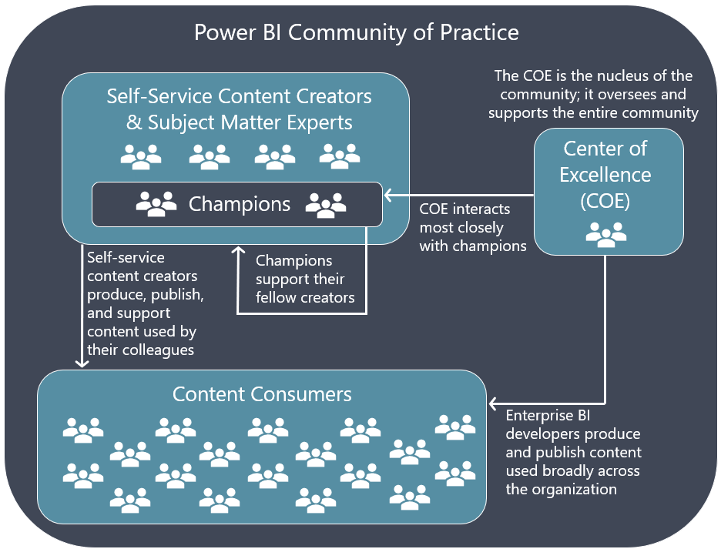
Community of Practice

Slide 155
Community of Practice
Champions Network
Knowledge Sharing
Power BI champions influence and help their colleagues in many ways including solution development, learning, skills improvement, troubleshooting, and keeping up to date.
Facilitate knowledge sharing among colleagues and across organization during the normal course of work or during a more structured activity, such as discussion channels, office hours with CoE, etc.
Incentives
Communication Plan
Empower and reward users who work for benefit of the community:
Contests with a small gift card or time off
Ranking based on help points
Leadership communication
Communication with community on:
COE exists and how to get help/support
Where to find resources and documentation
Where to find governance guidelines
How to share suggestions and ideas

Slide 156
Maturity Level – Community of Practice
Level | State of Power BI community
100: Initial | Some content creators do great work, but their efforts are unrecognized. Efforts to share knowledge are rare and unstructured. Communication is inconsistent.
200: Repeatable | The first set of champions are identified, and champions network goals are established. Knowledge sharing practices gain traction and are now more consistent.
300: Defined | Best practices are actively shared across the organization. Knowledge sharing in multiple forms is a normal and regularly scheduled occurrence. Goals for transparent communication with the user community are defined and executed with regularity.
400: Capable | Champions are established for all business units and actively support colleagues in their self-service efforts. Incentives to recognize and reward knowledge sharing efforts are a common occurrence. Regular and frequent communication occurs based on a predefined communication plan.
500: Efficient | Bidirectional feedback loops exist between the champions network and the COE.

Slide 157
User Support
9

Slide 158
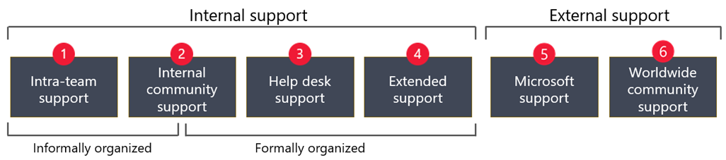
User Support
Intra-team support (internal) is very informal. Support occurs when team members learn from each other during the natural course of their job.
Internal community support (internal) can be organized informally, formally, or both. It occurs when colleagues interact with each other via internal community channels.
Help desk support (internal) handles formal support issues and requests.

Slide 159
User Support
Extended support (internal) involves handling complex issues escalated by the help desk.
Microsoft support (external) includes support for licensed users and administrators.
Community support (external) includes the worldwide community of Power BI experts, Microsoft MVPs, and enthusiasts who participate in forums and publish content.

Slide 160


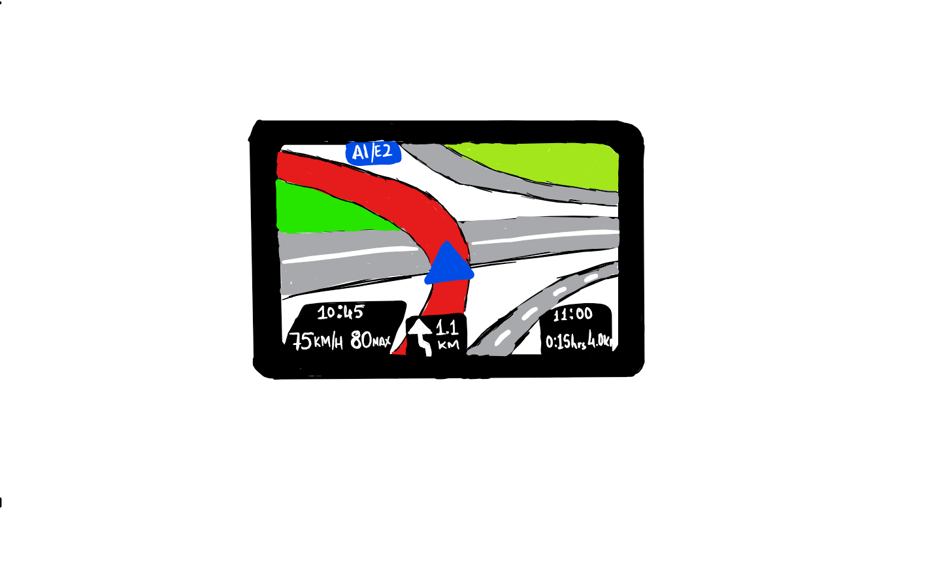
Types of Support
Break-fix
Minor Enhancements
Enablement

Slide 161
Break-fix
Mandatory Service
IT budget
Service knowledge is essential
Quick turnaround/ SLAs
Infrastructure/Service

Slide 162
Break-fix
Mandatory Service
Project budget
Project knowledge is important
Knowledge of the tools is essential
SLAs
Project

Slide 163
Minor Enhancements
Perceived as an essential service
Project Budget
Project knowledge is a nice to have
Knowledge of the tools is essential
Timescales agreed while scoping

Slide 164
Enablement
Organisational/Team Budget
Knowledge of the tools is essential
Real-time
Enablement hub

Slide 165
Break-fix / Minor Enhancements Options
Microsoft Power BI Support
Microsoft Premier Support
Internal Infrastructure Support
Internal BI Support team
Partners

Slide 166
Enablement Options
Centre of Excellence
Dedicated Power BI Enablement team
Lunch & Learn / Office hours
Internal website
Ongoing trainings
Advisory Service
Internal

Slide 167
Enablement Options
Power BI website, blogs, community portal
Online courses e.g. eDX
YouTube Power BI videos
Guy in a cube
Power BI User Groups
Community websites, blogs:
DAX Patterns
Power Pivot Pro
Chris Webb’s blog
Community

Slide 168
What do you need to consider when someone starts / changes role?
Actions
Document user rights changes
User from Gateway(s) – both admins and data sources
Pro license
Rollout / Removal of Power BI Desktop

Slide 169
What level of support will you give users?

Slide 170
Who will support Power BI?

Slide 171
Considerations & Key Actions

Slide 172
Maturity Level – User Support
Level | State of Power BI user support
100: Initial | Individual business units find effective ways of supporting each other, though tactics are siloed and not consistently applied. An internal discussion channel is available, but it's not monitored closely so the user experience is inconsistent.
200: Repeatable | The importance of intra-team support is encouraged and actively supported by the COE, including direct support of the champions network. The internal discussion channel gains traction as the default place for Power BI Q&A. The help desk handles a small number of the most common Power BI technical support issues.
300: Defined | The internal discussion channel is now popular and largely self-sustaining. COE members actively monitor and manage the discussion channel to ensure questions are answered quickly and correctly. The help desk is fully prepared to handle all known and expected Power BI technical support issues, and the COE provides appropriate extended support when required.
400: Capable | A recognition program is established, and it generates enthusiasm and encourages sharing best practices. SLAs are in place to define help desk support expectations, including extended support, and they are clear to everyone involved.
500: Efficient | Bidirectional feedback loops exist between the help desk and the COE. Key performance indicators measure community engagement and satisfaction. Automation is in place when it adds direct value to the user experience (for example, automatic access to the community), or for specific help desk activities (for example, use of APIs and scripts that increase speed and reduce error).

Slide 173
System Oversight
10

Slide 174
System Oversight Overview
Power BI Administration
Cost management
Service Management
Security and data protection
User machines and devices
Auditing and monitoring
Architecture
Planning for change
User licenses

Slide 175
System Oversight Overview
Power BI Administration
Cost management
Service Management
Security and data protection
User machines and devices
Auditing and monitoring
Architecture
Planning for change
User licenses

Slide 176
Admin Roles & Responsibilities
Role | Scope | Description
Power BI administrator | Power BI tenant | Manages tenant settings and other aspects of the Power BI service. All general references to administrator in this article refer to this type of administrator.
Power BI Premium capacity administrator | One capacity | Manages workspaces, workloads, and monitors the health of a Premium capacity.
Power BI gateway administrator | One gateway | Manages gateway data source configuration, credentials, and users assignments. May also handle gateway software updates (or collaborate with infrastructure team on updates).
Power BI workspace administrator | One workspace | Manages workspace settings and access.

Slide 177
PowerBI Management: What to Manage?

Slide 178



Azure Active Directory
PowerBI.com
Administration
Directory Synchronization
Manage Domains and Accounts
Manage login branding
Office 365
Directory and Account management
Subscriptions and licenses
Creating groups and organization apps
Enterprise IT management, usage monitoring and admin portal
Manage Subscriptions
License Assignment
Manage Domains and Accounts
Power BI
Create Workspaces
Create Apps
Tenant Settings
Monitoring
Manage gateways
Premium Capacity Management

Slide 179
Who is responsible for creating security groups?
Options
Office 365 Administrators
Azure Active Directory Administrator
Support Team

Slide 180
When should workspaces be created?

Slide 181
App Workspaces Creation Options
Option | Pros | Cons | Actions
Allow all users to create App Workspaces (Recommended) | Can be created whenever required | Can lead to lots of App workspaces | Monitor App Workspaces to identify unused workspaces and remove
Restrict to specific group of individuals | Groups creation can be validated | Delay in requesting a new workspace to be created | Define List of approved individuals and approvers Restrict group creation in O365 to above individuals Create Group request mechanism Update Tenant Setting Monitor App Workspaces to identify unused workspaces and remove

Slide 182
When to create an App Workspaces - Recommended
Option | How Many | Reasoning
BI Team Development | 1 | All Reports / Dashboards can be developed in 1 location Collaborative development area
BI Team Test | 1 | All Reports / Dashboards can be developed in 1 location Collaborative development area
BI Team QA | 1 per report category | Only 1 App can be created per Workspace Need to test App experience
BI Team Production | 1 per report category | Only 1 App can be created per Workspace Need to share with different audiences
Business Self-Service Development | 1 per department | Separate reports created by different departments Collaborative development area within a department
Business Self-Service Production | 1 per report category | Only 1 App can be created per Workspace Need to share with different audiences

Slide 183
Considerations for System Oversight
Verify who is permitted to be a Power BI administrator. If possible, reduce the number of people granted this role if it's more than a few people.
If you have people who occasionally need Power BI administrator rights, consider implementing Privileged Identity Management (PIM) in Azure Active Directory. It's designed to assign just-in-time role permissions that expire after a few hours.
Check the status of cross-training and documentation in place for handling Power BI administration responsibilities.

Slide 184
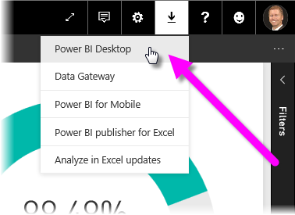
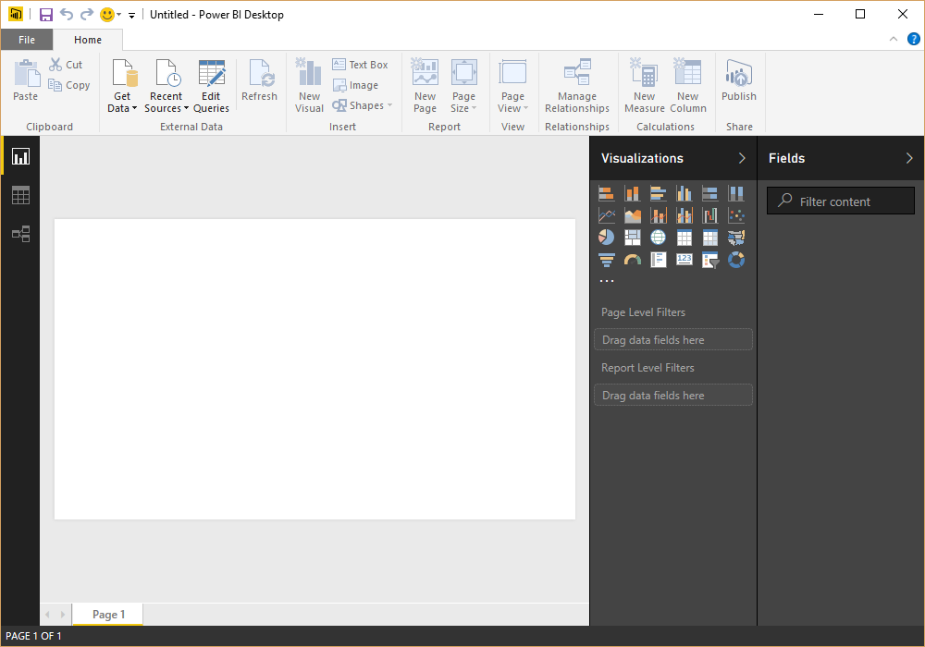
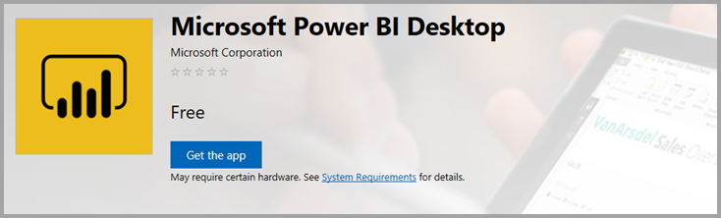
Power BI Desktop
Monthly Updates
Download from PowerBI.com
Packaged deployment from IT
Download from Windows Store

Slide 185
How will you manage installing Power BI Desktop?
Option | Pros | Cons | Actions
Windows 10 Store (Recommended) | Updates automatically installed Administrative privileges are not required. Download sizes are smaller Can be integrated with an organization’s roll-out policies and available via Microsoft Store for Business. | Less controls than System Center Configuration Manager. Requires Windows 10. | Sign up for Store for Business Decide on whether to distribute through the Store or a management tool Configure Store Add Power BI App and allow access to relevant individuals Users install Power BI Desktop from Microsoft Store.
Manually download and install | Timing controlled by the owner of the PC. | Requires administrative rights User machines may be out of sync, leading to compatibility issues. Every update requires action by the owner of the PC. | Make sure all relevant users are Admins
Organizational IT deployment tools such as Microsoft System Center Configuration Manager | The process is managed and handled by the organizational IT dept. | More complex. | Create package Agree frequency for package updates
Install Power BI on a Virtual Machine | The process is managed and handled by the organizational IT dept. Can easily update Can install additional items, e.g. drivers, R / Python, if required Offers the most control. | Need to provision, monitor and manage a Virtual Machine | Request Virtual Machine Build image for Virtual Machine, which includes required software and spec Make user an admin to allow them to install new updates

Slide 186
How will users install drivers on their machines (if required)?
Options
Manually Download and Install
Organizational IT deployment

Slide 187
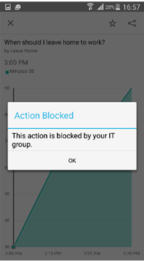
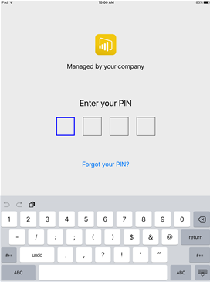

Mobile BI
Administration
Enterprise Mobile Device Management and app access control
Integrated InTune mobile application management (MAM) capabilities
Better control access to the data
Prevent data leakage

Slide 188
Do you want to manage mobile devices?
Options
Microsoft Intune
Other Mobile Application Management Tool
None

Slide 189
Who will be responsible for administering Power BI Mobile?

Slide 190
Azure Active Directory
PowerBI.com
Administration
Directory Synchronization
Manage Domains and Accounts
Manage login branding
Office 365
Directory and Account management
Subscriptions and licenses
Creating groups and organization apps
Enterprise IT management, usage monitoring and admin portal
Manage Subscriptions
License Assignment
Manage Domains and Accounts
Power BI
Create Workspaces
Create Apps
Tenant Settings
Monitoring
Manage gateways
Premium Capacity Management

Slide 191
Do you want to manage mobile devices?
Microsoft Intune
Set up Intune
Configure Power BI for use with Intune
Get URL for iOS and/or Android application
Create Mobile Application Management policy
Create the application
Deploy the application
Install the application on appropriate devices
Other Mobile Application Management Tool
Confirm tool can be used to administer Power BI Mobile
Configure Power BI Mobile
Install the application on appropriate devices
No
No action required

Slide 192
Service Management: How to Manage Power BI?

Slide 193
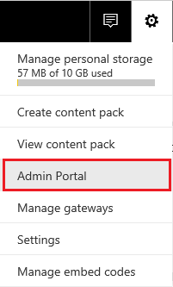
Admin Portal
Power BI Admin or Global Admin O365 Role

Slide 194




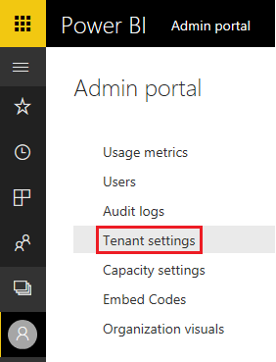

Tenant Settings
Export and Sharing Settings
Content Pack and App Settings
Integration Settings
Custom Visual Settings
R Visual Settings
Audit and Usage Settings
Dashboard Settings
Developer Settings

Slide 195
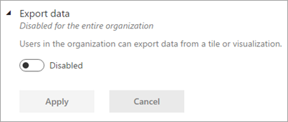
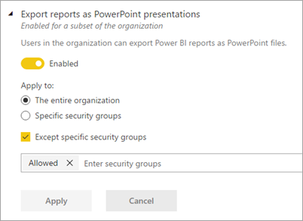
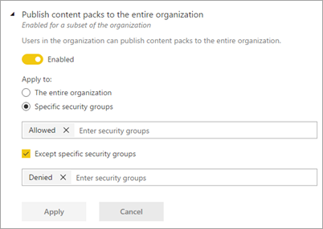
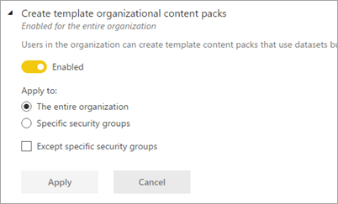
Granular Tenant Settings

Slide 196


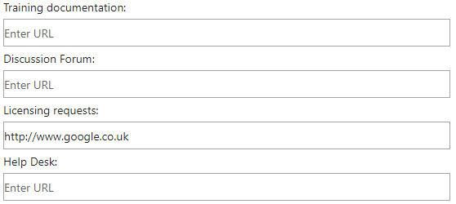


Learn
Community
Get Help
Licensing
Email Notifications
Help and Support Settings
Group Level
Default: Disabled

Slide 197

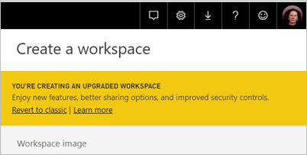
Workspace Settings
Create
Datasets
Group Level
Default: Enabled

Slide 198


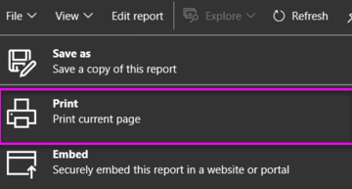


Export PowerPoint / PDF
Print
Email Subscription
Certification
Exporting and Sharing
Organizational Level
Group Level
Default: Disabled
Default: Enabled

Slide 199

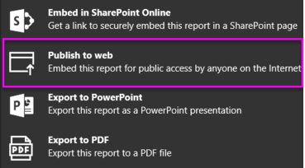


External Users
External Users can Edit
Publish to Web
Export Data
Exporting and Sharing
Group Level
Default: Disabled
Default: Enabled

Slide 200


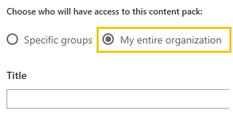

Entire Organisation
Template Apps
Push Apps
Content Pack and Apps
Group Level
Default: Disabled
Default: Enabled

Slide 201

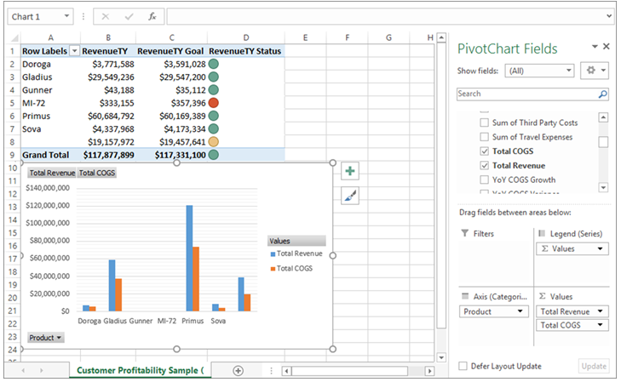

Integration
Analyze in Excel with On-Premises Datasets
ArcGiS Maps
Global Search
Group Level
Default: Enabled

Slide 202

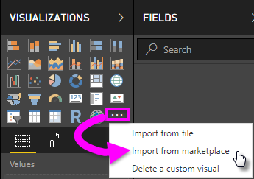
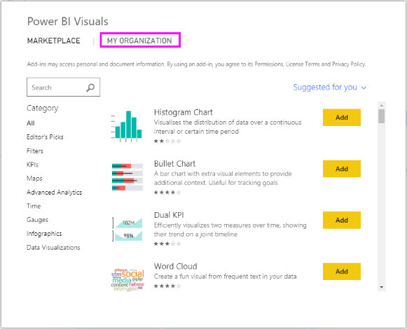
Custom Visuals
Certified Visuals
Organisational Visuals
R Visuals
Custom Visuals
Organizational Level
Group Level
R
Default: Disabled
Default: Enabled

Slide 203

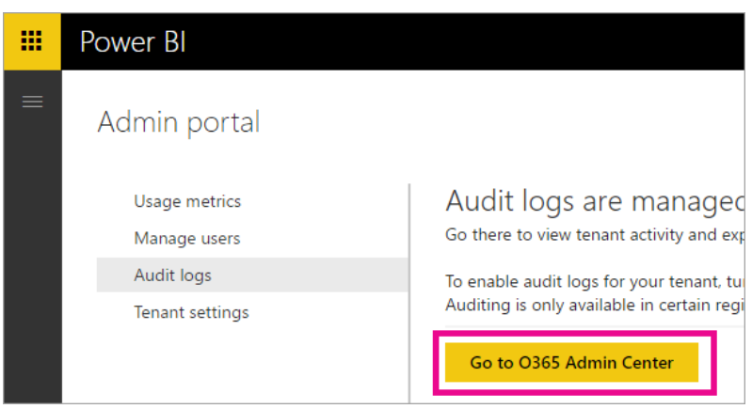

Create Audit Logs
Usage Metrics
Per-user Usage Metrics
Audit and Usage
Organizational Level
Group Level
Default: Enabled

Slide 204

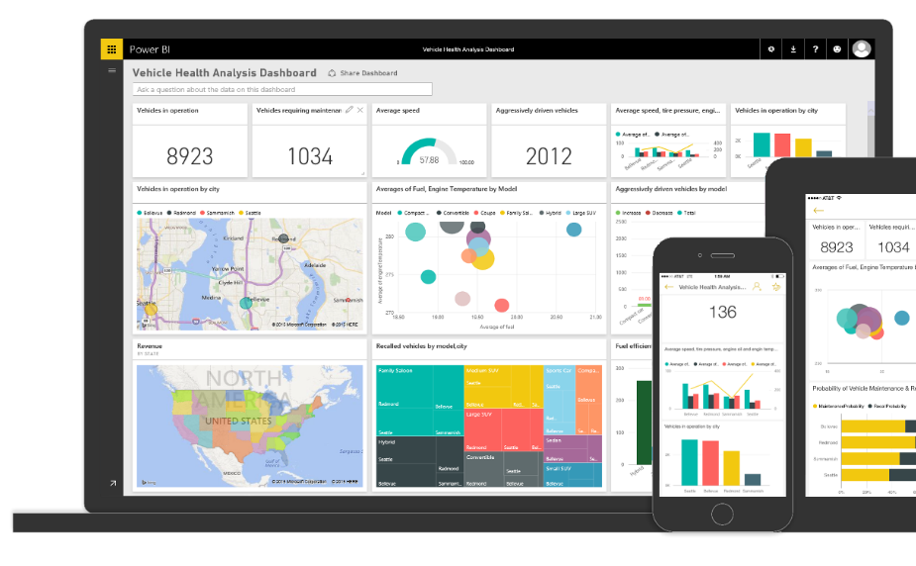
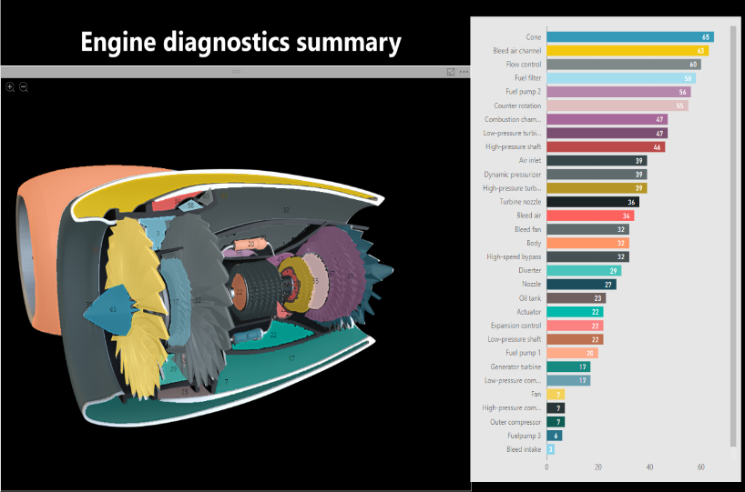

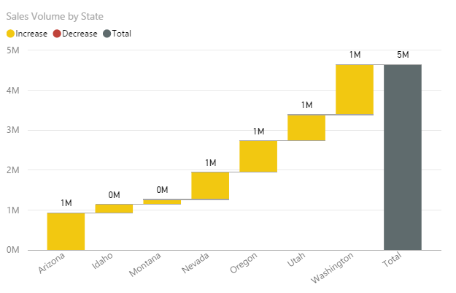
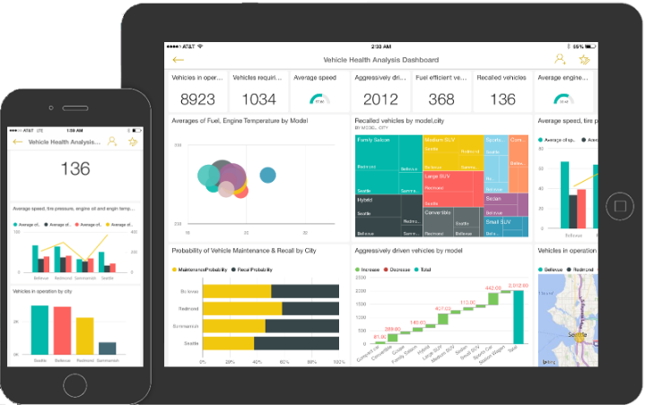
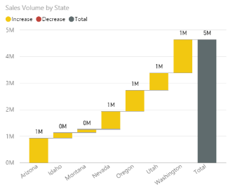

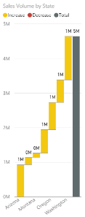

Developer
Embed in Apps
Service Principals
Group Level
Default: Disabled
Default: Enabled

Slide 205

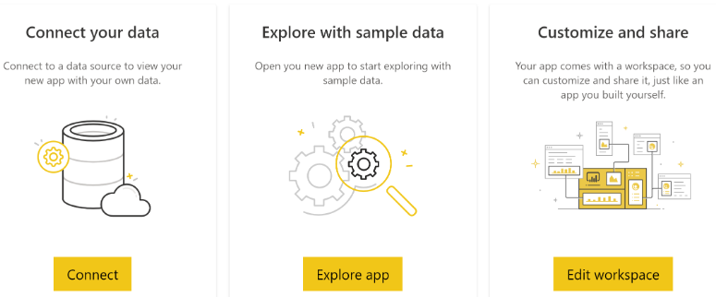

Publish
Install
Install (not listed in AppSource
Template App
Group Level
Default: Disabled
Default: Enabled

Slide 206


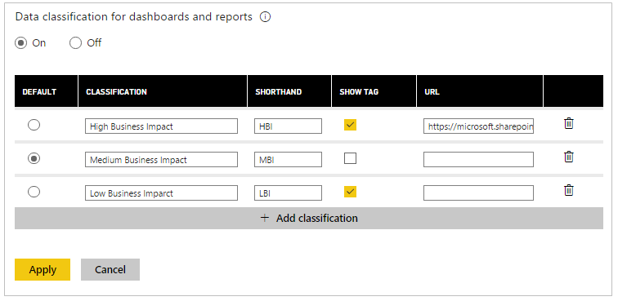

Data Classifications
Q&A
Dataflows
Other
Organizational Level
Group Level
Default: Disabled
Default: Enabled

Slide 207
What should the Power BI Tenant Settings be set to?
Actions
Login to Power BI Service
Select settings gear in the top right
Select Admin Portal
Navigate to Tenant Settings
Configure each setting appropriately

Slide 208
Who will be responsible for administering Power BI tenant settings?
Options
Office 365 Administrators
BI Team
Support Team

Slide 209
Considerations for Service Management
Conduct a review of all tenant settings and verify which groups are assigned for each setting.
Document the tenant settings for the internal Power BI community and post it in the centralized portal.
Customize the links under the Get Help menu option when user resources are established.

Slide 210

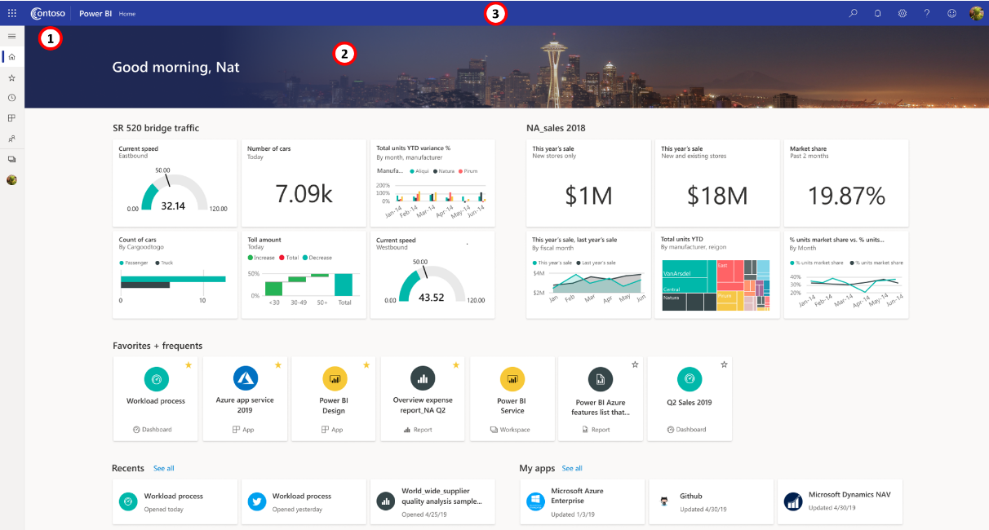

Custom Branding
Theme Colour
Logo
Cover Image

Slide 211
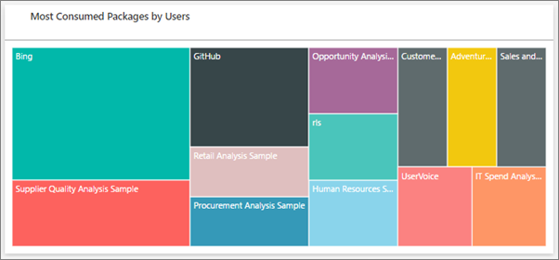
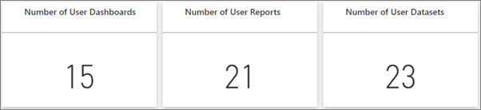
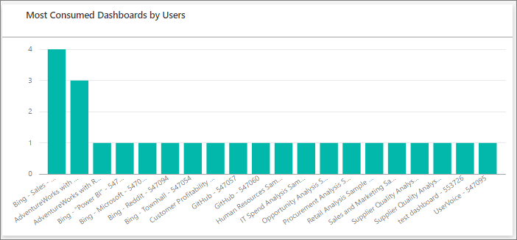
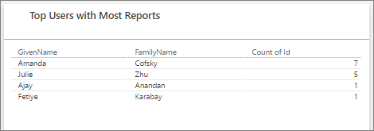

Usage Metrics – Admin Portal

Slide 212

Usage Metrics – Report / Dashboard

Slide 213
Auditing
Power BI Activity Log
REST APIs
Power BI Management Module
Usage and Performance Insights

Slide 214


Auditing

Slide 215
Categories of Auditing Data
Category of Auditing Data | Type of Questions
Usage patterns and adoption | What is the most often-used content, and by whom? How many users are active? Are report views trending up or down? Is there underutilized or abandoned content? Are viewers using browser or mobile apps more often? When is content published or updated, and by whom?
Governance, security, and compliance | When are workspace roles updated, and by whom? How many external users are accessing content? Who added or updated a sensitivity label? When does a tenant setting change, and by whom? What percentage of report views are based on certified datasets? What percentage of datasets support more than one report? How frequently is content downloaded, and by whom? Who generated an embed code for publish to web?

Slide 216
Categories of Auditing Data
Category of Auditing Data | Type of Questions
Architecture reporting and analysis | How many workspaces exist by type? How many reports exist by type? When is a gateway or data source created or updated?
User education and training opportunities | Who started a Power BI trial? Who is doing too much sharing from their personal workspace? Who is publishing a lot of new datasets? Who is doing a lot of exporting?

Slide 217
How will audit log data be used?
Who will backup the audit log to another location for reporting
Where will this backup reside?
How will this backup be created?
Who will create reports on the audit log data?
What types of reports can be created from the Audit log?
Who will these reports be shared with?

Slide 218
Considerations for Auditing & Monitoring
Begin retrieving data from the Power BI activity log if you are not currently compiling the raw data
Get started by using the Get-PowerBIActivityEvent PowerShell cmdlet included with the Power BI Management Module
Retrieve and store the raw data without filtering or formatting, to ensure that all data elements are available for future analysis
Ideal location is a file system or data lake
Over time, determine what additional auditing data would be helpful to complement the activity log data

Slide 219
Data Architecture
Fit in architecture | Where does Power BI fit into the organization's entire data architecture? Are there other existing components such as an enterprise data warehouse (EDW) or a data lake that will be important to factor into plans?
Capabilities | Is Power BI used end-to-end for data preparation, data modeling, and data presentation? Or is Power BI used only some of those capabilities?
Content Delivery | Where will users consume the content? Generally, the three main ways to deliver content are: the Power BI service, Power BI Report Server, and embedded in custom applications.
Management & Maintenance | Who is responsible for managing and maintaining the data architecture? Is it a centralized team, or a decentralized team? How is the COE represented in this team? Are certain skillsets required?
Data Sources | What data sources are the most important, and what types of data will we be acquiring?
Connectivity Modes | What connectivity mode and storage mode choices (for example, import, live connection, DirectQuery, or composite model frameworks) are the best fit for the use cases?
Shared datasets | To what extent is data reusability encouraged using shared datasets?
Dataflows | To what extent is the reusability of data preparation logic encouraged using dataflows?

Slide 220
Do you require connectivity to on-premises Data Sources?

Slide 221

What is an On-premises Data Gateway?
Facilitating the secure and efficient data transfer between organizational data sources and Power BI service.
Data Source:
Located within the enterprise data center
Configured behind a firewall
Within a virtual network
Within a virtual machine

Slide 222
Types of Gateways
Supports connections to registered data sources for many users to use.
Software installations and updates are installed on a machine that's managed by the customer.
On-premises Data Gateway
(Standard Mode)
On-premises Data Gateway
(Personal Mode)
Supports connectivity for many users.
Supports connectivity for datasets and dataflows stored in workspaces assigned to Premium capacity or Premium Per User.
Virtual Network Data Gateway
Supports data refresh only.
Typically installed on the PC of the user.
Supports use by one user only.
No support for live connection or DirectQuery connections.

Slide 223


1. Install an On-premises Data Gateway

Slide 224


2. Add users to an On-Premises Data Gateway

Slide 225


3. Connect to Data Sources

Slide 226



Guidance for On-Premises Data Gateways
Number of Users
Connection Type
Location
Monitoring
Recovery

Slide 227
Guidance for On-Premises Data Gateways
Number of Users
Are users going to use these reports at different times of the day?
Are all users using the same report?
Is a dashboard based on multiple reports?

Slide 228
Guidance for On-Premises Data Gateways
Connection Type
What type of connections are they going to use (DirectQuery or import)?
Gateway usage differs depending on connection type
Separate DirectQuery data sources from scheduled data refreshed sources where possible

Slide 229
Guidance for On-Premises Data Gateways
Location
Location of gateway installation can affect your performance
Minimize network latency through close proximity of your gateway, data source locations and Power BI tenant

Slide 230
Guidance for On-Premises Data Gateways
Monitoring
Use tools to monitor the use and performance of yoour installed gateway.
Make use of performance counters to understand types and volumes of activities.
Check configuration and service logs.
Check your gateway logs when connection is not working as expected.
Export all log files with Export logs button on the on-premise data gateway.
Enable verbose logging for additional information about query connection details.

Slide 231
Guidance for On-Premises Data Gateways
Recovery
Recover your existing gateway or move it to a new machine using recovery key
Recovery key is provided to the user who installs the gateway and cannot be changed later
Recovery key is used for data encryption and gateway recovery

Slide 232
Gateway Management
Departmental data source connectivity information and privacy levels.
Managed by decentralized data owners
Managed by centralized data owners
Centralized data source connectivity information and privacy levels.
Departmental data source stored credentials (including responsibility for updating routine password changes).
Departmental data source users who are permitted to use each data source.
Centralized data source stored credentials (including responsibility for updating routine password changes).
Centralized data source users who are permitted to use each data source.

Slide 233
Gateway Management
Managed by IT
Gateway software updates (gateway updates are usually released monthly).
Installation of drivers and custom connectors (the same ones that are installed on user machines).
Gateway cluster management (number of machines in the gateway cluster for high availability, disaster recovery, and to eliminate a single point of failure, which can cause significant user disruptions).
Server management (for example, operating system, RAM, CPU, or networking connectivity).
Management and backup of encryption keys.
Monitoring of gateway logs to assess when scale-up or scale-out is necessary.
Alerting of downtime or persistent low machine resources.

Slide 234
Who will be responsible for administering and monitoring Gateways?
Options
Office 365 Administrators
BI Team
Support Team

Slide 235
Where will Gateways be installed and how will they be configured?
Install new Gateway or add Gateway to existing cluster
Creation of new Server / VM – minimum spec
Install software
Backup the Key
Install drivers (if required, e.g. SAP)
Firewall or Port changes
Migrate / add connections if a new gateway
Decide if appropriate and add a user as an admin to a Gateway
They will add Data Sources and Add Users to existing data sources
Add data sources to a Gateway
Add users to a data source on a Gateway
These users can schedule a refresh for this data source using this gateway
Monitor
Use Windows Performance Monitor
Determine Baseline for “Normal” Load
Review slow performing queries by turning on tracing and checking logs
Take Action
Scale the gateway server
Add a new gateway
Add a new cluster to an existing gateway
Feedback to users to change refresh time or performance tune report

Slide 236
Considerations for Data Architecture Planning
Assess what your end-to-end data architecture:
How Power BI is currently used by the different business units in your organization versus how you want Power BI to be used. Determine if there's a gap.
If there are any risks that should be addressed.
If there are any high-maintenance situations to be addressed.
What data sources are important for Power BI users, and how they are documented and discovered.
Review existing gateways that are used in your organization.
Check number of personal gateways that are in use, and by whom.

Slide 237
Power BI Premium

Slide 238
How will you purchase and configure Premium?
Decide and purchase new Premium nodes
Purchase via Admin Portal or via partner
Decide if appropriate and add a user as an admin to a capacity
Office 365 Global Administrators and Power BI Service Administrators are automatically granted this
Recommend adding BI Team and support to help, reducing dependency on only admins
Grants a user the ability to assign a Workspace to a Premium capacity – users without a Pro license can view content shared to them from that Workspace
Set up a new capacity
Go to Admin Portal in Power BI Service
Go to Capacity Settings
Select Set up new capacity
Select Capacity Size
Consider which Workspaces will be on this Capacity
See When to create an App Workspaces and When to add a Workspaces to Premium

Slide 239



Premium Capacity Management

Slide 240
How to use Premium Capacity- Recommendation
Option | No. Workspaces | Add to Premium | Which Capacity
BI Team Development | 1 | No | All users will have Pro license
BI Team Test | 1 | No | All users will have Pro license If testing is done via an app and Testers do not have a Pro license then Add to Premium
BI Team QA | 1 per report category | Yes | Share a single QA Capacity Small reports share 1 capacity
BI Team Production | 1 per report category / solution | Yes | Share capacity for small reports Important or heavy reports in separate capacity
Business Self-Service Development | 1 per department | No | All users will have Pro license
Business Self-Service Production | 1 per report category / solution | Yes | Share 1 capacity Important or heavy reports should be considered for migration to a BI Team Production workspace

Slide 241
How will you purchase and configure Premium?
Decide and purchase new Premium nodes
Purchase via Admin Portal or via partner
Decide if appropriate and add a user as an admin to a capacity
Office 365 Global Administrators and Power BI Service Administrators are automatically granted this
Recommend adding BI Team and support to help, reducing dependency on only admins
Grants a user the ability to assign a Workspace to a Premium capacity – users without a Pro license can view content shared to them from that Workspace
Set up a new capacity
Go to Admin Portal in Power BI Service
Go to Capacity Settings
Select Set up new capacity
Select Capacity Size
Consider which Workspaces will be on this Capacity
See When to create an App Workspaces and When to add a Workspaces to Premium

Slide 242


Premium Capacity Monitoring

Slide 243
How will you monitor Premium?
Monitoring a Premium capacity
Install the Premium Capacity Metrics App
In Power BI, click Apps
On the right side, click Get apps
In the Apps category, search for Power BI Premium Capacity Metrics app
Subscribe to install the app
Review Performance
Datasets: detailed metrics on the health of the Power BI datasets in your capacities.
Paginated Reports: detailed metrics on the health of the paginated reports in your capacities.
Dataflows: detailed refresh metrics for dataflows in your capacities.
Resource Consumption: overall capacity metrics including memory and CPU high utilization.
IDs and Info: names, IDs, and owners for capacities, workspaces, and workloads.
Manage and Optimize Premium capacities
Based on monitoring consider the following actions:
Purchase a new Premium capacity
Move workspaces / reports to different capacities
Feedback to users to change refresh time or performance tune report

Slide 244
Security

Slide 245
PowerBI Security: User Identity

Slide 246


User Identity
Runs on Azure
Azure Active Directory
Users and Groups

Slide 247


User Identity
Managed Identities
Federated Identities
On-Premises Directory

Slide 248


Power BI Authentication
ATM (Azure Traffic Manager)
AAD
Azure CDN
WFE
Global Service
(Azure Table)
ASP.NET
Backend Service
Browser
app.powerbi.com
Microsoft Login

Slide 249




Multi-Factor Authentication
Office 365 / AAD Premium
Phone Call
Text
App

Slide 250



User Access Control
Mobile Device Policies
Intune
Company Portal

Slide 251


Conditional Access
IP Addresses (corp net)
Devices
Users / Groups
Multi-factor Auth

Slide 252
Admin Control
Self Sign-Up
Sharing
Exporting

Slide 253
Do you want to add controls for Power BI Environment Access?
Do you want users to be able to access non-corporate tenants?
Block access to Office 365 tenant
Do you want to have 2 factor authentication for user access?
Review / purchase licenses that include MFA, like Azure Active Directory Premium
Enable MFA in the Office 365 Admin Centre for all required users
Do you want to disable self sign-up for Power BI?
Disable this feature at O365 level

Slide 254
PowerBI Security: What to Secure?

Slide 255
Why Security needs to be reviewed
Data Location
On-Premises
Cloud
Data Access
Sharing
Row-Level Security
Public

Slide 256

Considerations
Data Classification
Data source access
Security trimming
Data Preparation
Excel / Flat file
Data Sources

Slide 257


Where is your data?
Cloud
On-premises
How do you refresh?
Personal gateway
On-premises data gateway
How do you connect?
Import data
Direct / Live query
Connecting data to Power BI

Slide 258

Cloud Models
Dataset metadata and data stored in Power BI
External Models
Dataset metadata stored in Power BI
Data stored externally
How Power BI views your data model

Slide 259
PowerBI Security: Architecture

Slide 260


Tenants
Distinct and Separate
Users and Company
Single location

Slide 261



Web Front End Cluster
Azure Active Directory
Azure Traffic Manager
Azure Content Delivery Network

Slide 262

Back End Cluster
Visualisations
Data
Service Interactions

Slide 263


Data Encryption
At Rest
In Process

Slide 264
Data At Rest
Datasets
Reports
Dashboards

Slide 265


Data Encryption
Azure SQL Database
Transparent Data Encryption (TDE)
Managed by Azure SQL
Azure Blob Storage
CEK - AES_CBC_256 Key
KEK – A256KW 256-bit Key

Slide 266

Data In Process
Data Role
Analysis Services Model
Visual Caches

Slide 267


Where is my data stored?
Is my data stored in same region?
Data Sovereignty
Europe | North Europe (Ireland) West Europe (Netherlands)
Australia | Australia East (New South Wales) Australia Southeast (Victoria)
United Kingdom | UK South (London, England) UK West (Cardiff, Wales)

Slide 268


ExpressRoute
Bypass the internet
Built-In Redundancy
Predictable network performance and availability

Slide 269



ExpressRoute
Desktop / Gateway
Public Content Packs
Telemetry Data
Map Visuals
Cortana
Custom Links
Exceptions

Slide 270
Do you want to bypass the internet when connecting to Power BI?
Actions
Confirm ExpressRoute prerequisites met
Find an ExpressRoute connectivity provider
Create an ExpressRoute circuit
Create routing for ExpressRoute circuit
Link Virtual Network to ExpressRoute

Slide 271
Compliance and market availability
COMPLIANCE | AVAILABILITY
CCSL (IRAP) | √
China GB 18030 | √
CJIS | √
CSA STAR Attestation | √
CSA STAR Certification | √
DoD | √
EU Model Clauses | √
EU-U.S. Privacy Shield | √
FedRAMP | √
FERPA | √
FIPS 140-2 | √
COMPLIANCE | AVAILABILITY
FISC | √
HIPAA/HITECH | √
ISO 27001 | √
ISO 27018 | √
MeitY | √
NZ CC Framework | √
PCI DSS | √
SOC 1 | √
SOC 2 | √
SOC 3 | √
UK G-Cloud | √
REGIONS DATA LOCATIONS | AVAILABILITY
Asia Pacific | √
Australia | √
Brazil | √
Canada | √
Europe | √
India | √
Japan | √
United Kingdom | √
United States | √
NATIONAL CLOUDS | AVAILABILITY
US Government | √
China | √
Germany | √
All dates are subject to change;
https://www.microsoft.com/en-us/trustcenter/compliance/complianceofferings?product=PowerBI
Audit schedules are hard to predict and can be outside Microsoft’s control. Some certifications have an annual audit window and failure to pass the audit could result in a 1 year delay.

Slide 272
PowerBI Security: How to Secure?

Slide 273

Data Security
Row-Level Security
Roles
Import or Direct Query
Analysis Services Inherits

Slide 274


Dynamic Row Level Security
Dynamic
Reduces Maintenance
USERNAME()
USERPRINCIPALNAME()

Slide 275
Sharing
App Workspaces / Apps
Reports & Dashboards
Public
Printing

Slide 276


Collaborative Development
Anyone can Create
Workspace OneDrive
Belong to Many
Pro License
Sharing
App Workspaces

Slide 277



Sharing
Requires App Workspace
Multiple Assets
Broad Audience
Read-Only
Download or Push
Staged Changes
Pro or Premium
Apps

Slide 278


External Users
Any Email Address
Planned or Ad-hoc Invites
App sharing
Pro or Premium
Sharing
AAD B2B

Slide 279

Sharing
Share from Anywhere
Read-Only
External Users
Pro or Premium
Reports & Dashboards

Slide 280



One Source of Truth
Cross Workspace
Certify
Promote
Pro or Premium
Sharing
Dataset

Slide 281

Sharing
Publicly available
Embed on Websites
Data Refresh
Public

Slide 282


Entire Dashboard or Tile
Report page or Visual
Single Page
Export to PDF
Sharing
Printing
PDF

Slide 283



Each page becomes a slide
Single image in PowerPoint
Filters are preserved
Has a link to the report
Sharing
PowerPoint

Slide 284
When should you use the various sharing options?
Share Individual Dashboards / Reports
App Workspaces
Apps
Audience Size
Small
Small
Large
Common Scenario
One off sharing
Development, i.e. collaboration with edit permissions
Content Distribution; View access
Type of Users
Individuals
Distribution Groups
AD security groups
Does NOT work with Dynamic Distribution Groups
Individuals
Security Groups (new Workspaces – in preview)
Distribution Lists (new Workspaces – in preview)
Office 365 Groups (new Workspaces – in preview)
Everyone
Individuals
AD Security Groups
O365 Dependency
No
Current workspaces create an 0365 group, but Workspaces currently in Preview do not.
No
License Requirements
Pro License or PBI Premium
Pro License
Pro License or PBI Premium
References
Share your Power BI dashboards and reports with coworkers and others
Create workspaces with your colleagues in Power BI
Create the new workspaces (preview) in Power BI
Publish apps with dashboards and reports in Power BI

Slide 285
Improve Security & Data Protection
Clarify exactly what the expectations are for data protection, and ensure those expectations are communicated to the community of users.
Understand and document the organizational policies around sharing Power BI content with external users, and ensure that Power BI service settings support those policies.
If they do not currently exist, begin the process of deciding on sensitivity labels. Involve the relevant IT teams for decision-making and configuration in Microsoft 365.
Investigate the use of Microsoft Cloud App Security to monitor user behavior and activities in the Power BI service.

Slide 286
Maturity Level – System Oversight
Level | State of Power BI system oversight
100: Initial | Tenant settings are configured independently by one or more administrators based on their best judgment. Architecture needs, such as gateways and capacities, are satisfied on an as-needed basis, though without a strategic plan. Power BI activity logs are unused, or selectively used for tactical purposes.
200: Repeatable | Tenant settings are reviewed on a regular basis, and purposefully align with established governance guidelines and policies. A small number of specific administrators are selected, and they have a good understanding of what users are trying to accomplish. An effective process exists for users to request licenses and software. Sensitivity labels are configured in Microsoft 365, though usage of labels remains inconsistent.
300: Defined | The tenant settings are fully documented in the community portal for users to reference, including how to request access to the correct groups. Cross-training and documentation exists for administrators to ensure continuity and stability. Sensitivity labels are assigned to content consistently. An automated process is in place to export Power BI activity log and API data to a secure location for reporting and auditing.

Slide 287
Maturity Level – System Oversight
Level | State of Power BI system oversight
400: Capable | Automated policies are configured and actively monitored in Microsoft Cloud App Security for data loss prevention. Administrators work closely with the COE and governance teams to provide oversight of Power BI with an emphasis on user empowerment within the requisite guardrails. Decentralized management of data architecture (such as gateways or capacity management) is effectively handled to balance agility and control. Power BI activity log and API data is actively analyzed to monitor and audit Power BI activities. Proactive action is taken based on the data.
500: Efficient | Regular cost management analysis is done to ensure user needs are met in a cost-effective way. Power BI activity log and API data is actively used to inform and improve adoption efforts (in addition to monitoring and auditing of Power BI activities).

Slide 288
PowerBI Service Management: Licensing

Slide 289
Power BI family
Author
Share and collaborate
Large scale deployments
Power BI Desktop
Power BI Pro
Power BI Premium
Free data analysis and report authoring tool
Cloud-based modern business analytics solution
Dedicated capacity for increased performance

Slide 290
Power BI Premium Licensing
What is Power BI Premium?
Dedicated resources in the cloud
Flexibility to license by capacity
Greater scale and performance
Embedded analytics
Paginated Reports
Incremental Refresh
Multi-Geo
Licensing
Power BI Premium is available in node configurations with different v-core capacities – see Power BI Premium whitepaper
P nodes can be used for embedded (PaaS) or service (SaaS) deployments
EM3 node can only be used for embedded deployments
Power BI Premium includes the right to run Power BI Report Server on-premises

Slide 291
How to acquire Power BI SaaS Offering
Power BI Pro
+
Power BI Premium
Standalone
$9.99/user/month
Add on to Power BI Pro
Includes Power BI Report Server
Office 365
Included in E5
Add on for E1/E3
Concurrently deploy an equivalent number of cores on-premises
SQL Server
Customers with SQL EE SA also have access to Power BI Report Server as a SA benefit

Slide 292









Licensing Scenario
5,000 Pro (via E5)
500 Pro (standalone)
Finance
Analyze several large datasets requiring unthrottled and isolated capacity
HR
Extend read access to BI content throughout the organization
Premium nodes
Power BI Report Server extends hybrid capabilities, including on-premises report publishing
Rest of company (e.g. Customer Service, Engineering, Manufacturing, Sales)
Consume BI content

Slide 293
What licensing do you currently have available?
Actions
Document current licenses
Discuss potential usage

Slide 294
Do you require Power BI Premium?
How many report consumers are there?
Do you need larger model sizes?
Do you need Premium on functionality?

Slide 295


Sample License Assignment Workflow 1
Programmatic License
Assignment

Slide 296



Sample License Assignment Workflow 2
License request
form
Usage guideline
video
Certified to use
Programmatic License
Assignment

Slide 297

Sample License Assignment Workflow 3
Author
Usage guideline
video
Certified to use
Programmatic License
Assignment and Desktop Availability
Business Case
O365 Group/ App Workspace
Provisioning
Consumer
Programmatic License
Assignment
Optional Intro Video

Slide 298
Sample License Assignment Workflow 4
Author
Usage guideline
video
Certified to use
Programmatic License
Assignment and Desktop Availability
Business Case
O365 Group
Provisioning
Consumer
Optional Intro Video

Slide 299
How will you assign Power BI licenses?
Options
Assign All users at release
Phased rollout to All users over time
Assignment on Request
Discuss an Approval process

Slide 300
How will you assign Power BI licenses?
Options
Assign All users at release
Phased rollout to All users over time
Assignment on Request
Discuss an Approval process

Slide 301
What licences are required by role?
Role | License | Desktop | Information
Consumer (with Premium) | Power BI Free | No | Uses Power BI Service Only consumes content created by others
Consumer | Power BI Pro | No | Uses Power BI Service Only consumes content created by others
Analyst | Power BI Pro | Yes | Creates and shares content
Power User | Power BI Pro | Yes | Creates and shares content
BI Developer | Power BI Pro | Yes | Creates and shares content
Web / App Developer | Power BI Free | No | Embeds content in apps created by others Generally uses a single user for all embedded solutions
IT Operations User | Power BI Pro | Yes | Requires Power BI Administrator role in Office 365
IT Support User | Power BI Pro | Yes | Will look at existing solutions and likely debug in Desktop

Slide 302
PowerBI Rollout

Slide 303
Power BI Roll-Out

Slide 304
Need for a Roll-out Strategy
Plan for adoption
Training needs
Change management
Project Prioritisation
Roll-Out strategy
Smooth roll-out
Enables employees
Timely support

Slide 305




Roll-Out Considerations
Phased vs Organisation wide roll-out
License assignment process
Roll-out of Power BI Desktop
Project selection
Change management
Communications
Training

Slide 306
Phased Roll-out
Corporate BI
Product evaluation
Governance and security standards
Infrastructure setup
Support structure
IT led solution delivery
Training Program
Business-Led Self Service BI
Build on the foundation laid down by IT
Identification of Power BI Champions
Roll-out at a team/department level

Slide 307
Enterprise-wide Roll-out
Corporate BI
Business-Led Self Service BI
Start gaining benefits of the tool immediately
Product evaluation
Governance and security standards
Centrally Managed Service
Support structure
IT led solution delivery
Power BI Champions will emerge
End user/ Power user training
Infrastructure setup
Support structure
Infrastructure setup

Slide 308
Power BI Desktop Roll-out
How
Why
Authoring requires some governance
Consider Phased roll-out
Capacity to support
Capacity planning
Update frequency
Alignment with training
Audit and security readiness

Slide 309
Project Selection
How
Why
Quicker Development
Existing SSAS Cubes
Wider Reach
Existing Data Warehouses
Greater Business Impact
High level aggregate data
Minimal disruption
Excel/Access based solutions
Prototyping stage

Slide 310
Have you identified initial projects to work on?

Slide 311
Change Management
How
Why
Case for change
Change Management specialists
Smooth transition
Change Management platforms
Process of transition
Clarity on timelines
Switchover/ Parallel run

Slide 312
Project Videos
How
Why
Great starting point
Introduction to the project
Available on demand
Highlight key capabilities
Preferred format
Usage scenarios
Next steps/Go-Dos

Slide 313
Communications
How
Why
Avoid confusion and uncertainty
Purpose alignment
Signposting
License assignment
Governance overview
Key contacts
Getting started

Slide 314
Training
How
Why
Enable employees appropriately
Training needs assessment
Minimize fear and resistance
Establish training programs
Minimize Risk
Leverage online resources
Pilot training and feedback

Slide 315
PowerBI Roll Out: User Roles

Slide 316
Power BI user Roles
Consumers
Analysts
Power Users
IT Operations
IT Support
BI Development Team
Web Development Team

Slide 317
Consumers
Description: Consume content created by others to make data driven decisions
Role: View content that has been developed by BI Developers, Power Users and Analysts
Training Requirement:
Signing into the service
Familiarity with the service and the mobile app
Navigation
Dashboards
Viewing reports
Ad-hoc analysis
Alerts / Subscriptions
Q&A

Slide 318
Analysts
Description: Consume content created by others and creating new reports and dashboards from corporate data models
Role: View, edit and content that has been developed by BI Developers, Power Users and Analysts
Training Requirement:
End User Training
Power BI Desktop
Data Load
Data mashup
Data modelling overview
Advanced visualisation
Intermediate DAX

Slide 319
Power Users
Description: Develop content for use by a Project Team or Department
Role: Create and publish content
Training Requirement:
Analyst Training
Organisational governance strategy
Microsoft Data Analytics platform
Power BI Desktop
Data modelling scenarios and techniques
Data blending techniques and best practices
Advanced M and DAX
Power BI Service
App Workspaces
Apps
Real-time dashboards

Slide 320
BI Development Team
Description: Develop approved enterprise wide content and products
Role: Creating data models, reports, applications and insights for colleagues throughout the business to consume
Training Requirement:
Power User Training
Surfacing a variety of data for Power BI consumption
Integration with the existing BI environment
Keeping data current
SSAS Tabular
ALM and Release management

Slide 321
Web Development Team
Description: Develop internal and external applications
Role: Embed Power BI solutions in applications
Training Requirement:
Embedding Power BI into web solutions
Organisational governance strategy
Real-time data
Developing Custom Visuals

Slide 322
IT Operations / BAU Support
Role Description: Ensure day to day operations are smooth
Role: Responsible for resolving urgent infrastructure issues and configuring Power BI settings
Training Requirement:
End User Training
Service Management
Audit
Usage reporting
Gateway installation, management and Monitoring

Slide 323
IT Minor Enhancements Support
Role Description: Support enterprise wide content and products.
Role: Maintain corporate Power BI solutions, making minor enhancements, solving complex issues, monitoring usage and performance
Training Requirement:
Power User Training
BI Development team training
Web Development team training
Managing data sources
Managing gateway connections

Slide 324
What are the user roles for Power BI in your organization?

Slide 325


Potential end to end process
MASTER DATA & DATA QUALITY
1
Add new reporting data source
1
DATA SOURCES
6
ANALYSTS/POWER USERS
7
PowerBI.com
2
Perform data source security and governance management tasks
Organizational Content Packs
Shared Data Sources
Shared Datasets
Shared Data Models
Reports and Dashboards
Groups Workspaces
OneDrive for Business
SharePoint Lists
2
SECURITY, ROLES, DATA SOURCES, DATA CATALOG, MASTER DATA VERSION CONTROL AND AUDIT
3
Publish approved shared data source for analysts/power users
BIG DATA/DATA LAKE
4
Develop reporting content with approved shared data sources
CLOUD APPS, STREAMS & IOT DATA
3
APPROVED SECURE SHARED DATA SOURCES, DATASETS VIA ENTERPRISE DATA GATEWAY AND/OR CONTENT PACKS
5
APPROVAL WORKFLOW TO DEPLOY
5
Submit reporting content for approval
based on Governance Guidelines
6
Review, approve/disapprove, add to catalog for compliance and audit
DATA WAREHOUSE & APP DATABASES
4
POWER BI DESKTOP,
EXCEL, R, AZURE ML & OTHER TOOLS
8
Publish approved content with permissions to groups
7
ANALYSIS SERVICES
BI SEMANTIC MODELS
8
View and explore Power BI content based on role/group permissions
ANALYSTS/POWER USERS
SELF-SERVICE BI USERS

Slide 326
Wrap-Up: Adoption Roadmap

Slide 327
What were the main learnings?

Slide 328
Next Steps in Adoption
Workshop
Follow-up Discussions
`
Documentation
Plan

Slide 329
Adoption Framework - Output

Slide 330
Thank you!

